Slide 1

X
CoTiMA
o
Christian Dormann, Christina Guthier & Jose Cortina
www.applied-psychology.com
Notes:
Hello and welcome to CoTiMA,
This tutorial introduces a method allowing to meta-analyze longitudinal or panel studies, in which one or more variable is measured repeatedly.
The method is called Continuous Time Meta-Analysis, and it’s acronym is CoTiMA.
The tutorial does not go too much into the mathematical details; rather, it shows how to conduct a CoTiMA using R. Mathematical and statistical details can be found in the article by Dormann, Guthier & Cortina, which was published in Organizational Research Methods.
You do not need to have knowledge about R. The tutorial starts with a brief explanation of how to install R. The tutorial uses the R-script that are provided as supplementary online material to the article in Organizational Research Methods.
You could also download them from www.applied-psychology.com
After going through this tutorial, you should be able to conduct your own CoTiMA and interpret the results.
So let us start!
Some tips first:
The slides run automatically. So you could just lay back and enjoy.
If you want to move to the respective next slide faster, then you could do several clicks with your mouse or enter the number of the next slide and then press enter.
If you want to pause in the middle of a slide, just press the right mouse button. The right one.
All right.

Slide 2
Continuous Time Meta-Analysis CoTiMA
When CoTiMA is useful
JS_{t0}
JS_{t1}
JP_{t0}
JP_{t1}
Notes:
Many longitudinal studies investigate regression models or structural equation models of this kind.
In this model, job satisfaction and job performance are measured at two time points. To be consistent with the language used in continuous time modeling, the two time points are called Time zero and Time 1.
Job satisfaction at Time zero is proposed to affect Job satisfaction at Time 1. This is called the auto-regressive effect. In continuous time modeling, it is simply called auto effect.
Job satisfaction at Time zero is further proposed to affect Job performance at Time 1. This is called the cross-lagged effect. In continuous time modeling, it is simply called cross effect.
In a similar fashion, job performance has an autoregressive effect, too, and it also has a cross-lagged effect on job satisfaction Time 1.
In most instances, researchers are interested in meta-analyzing cross-lagged effects.
=>Sometimes, however, researchers are interested meta-analyzing in the stability or auto-regressive effects only. This is also possible with CoTiMA.
By the way, there are other terms for meta-analyzing effects that are frequently used in the literature, such as aggregating effects or synthesizing effects. Basically, they all mean the same.

Slide 3
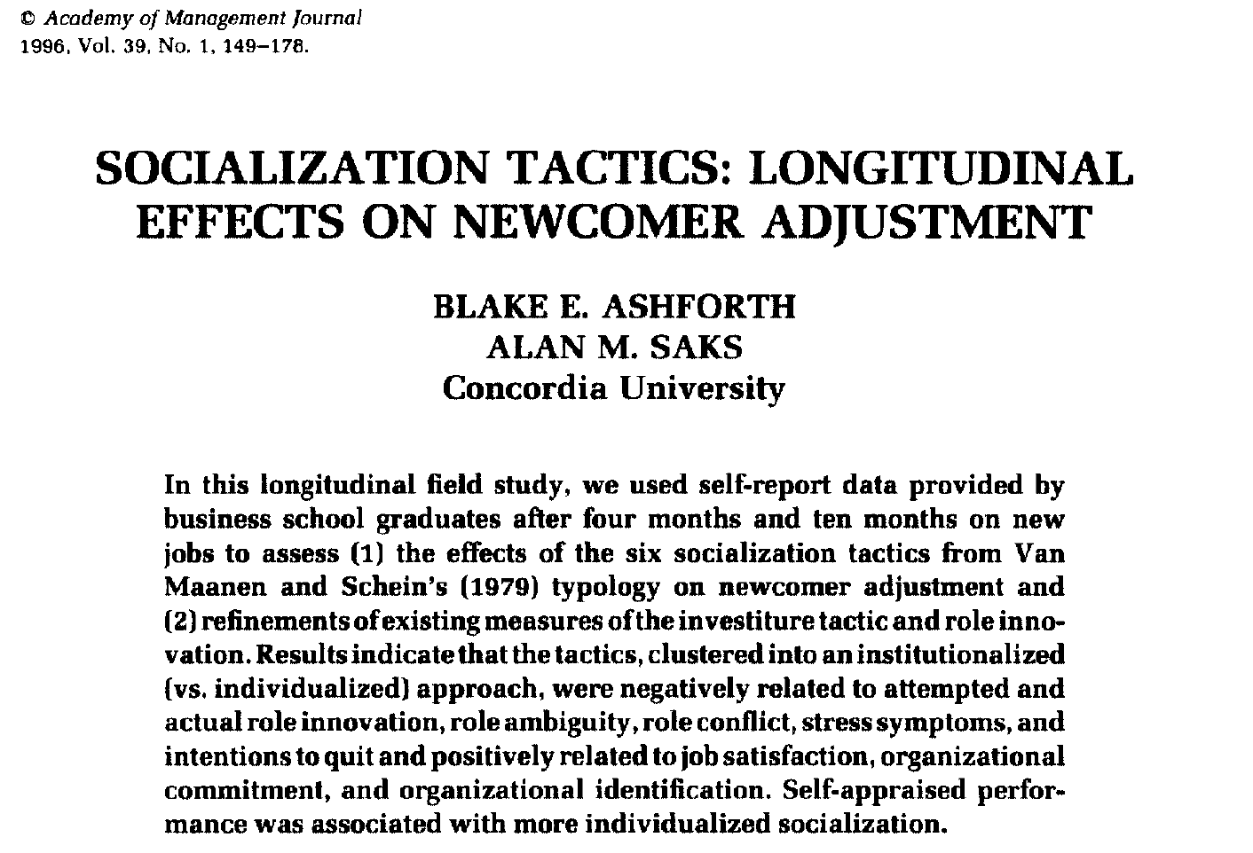
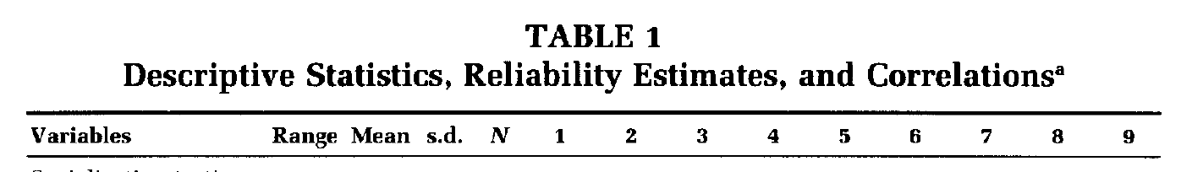
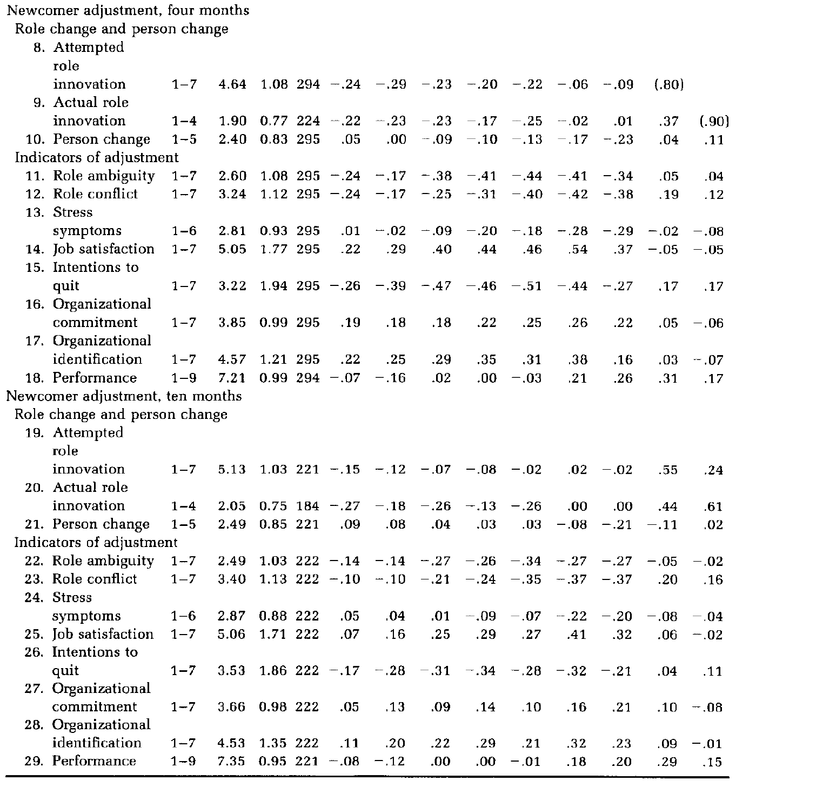
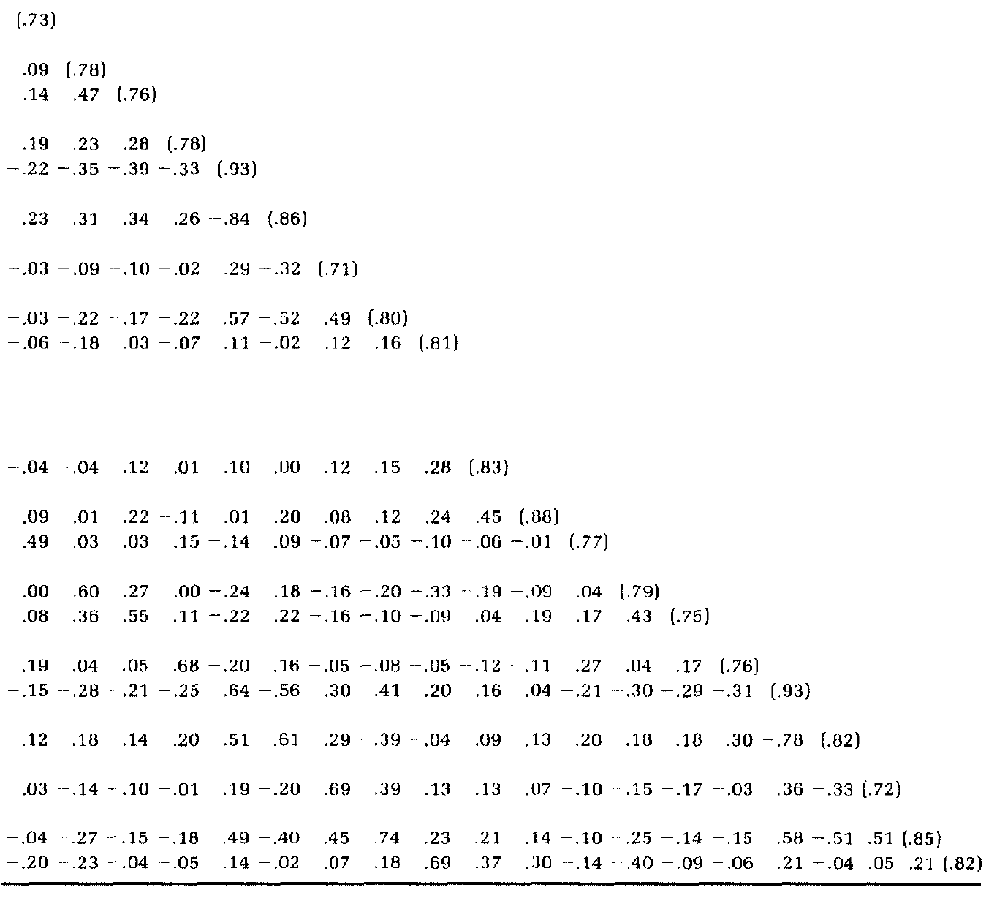
Continuous Time Meta-Analysis CoTiMA
When CoTiMA is useful
JS_{t0}
JS_{t1}
JS_{t0}
JS_{t1}
JP_{t0}
JP_{t1}
JP_{t0}
JP_{t1}
Notes:
What you will need to conduct a CoTiMA, however, are neither auto-regressive nor cross-lagged effects. This is really good because many primary studies do not report all of them.
Luckily, most primary studies report correlations among the variables, and this is what we need for CoTiMA.
By the way, in the figure on the top right, we have replaced the single-headed arrows by double-headed errors; this is the common way to show correlations in path diagrams.
Let us look at an example.
This is the study by Ashforth and Saks published in the Academy of Management Journal in 1996 and it is entitled “Socialization tactics: Longitudinal effects on newcomer adjustments”.
In this study, a huge bunch of variables were collected at two measurement occasions.
We have skipped some variable from their Descriptive Statistics Table, which is still large.

Slide 4
Continuous Time Meta-Analysis CoTiMA
When CoTiMA is useful
.64
JS_{t0}
JS_{t1}
.14
.11
.21
.20
JP_{t0}
.69
JP_{t1}
Notes:
Job satisfaction at Time Zero is located in row and column number 14.
In column 14, we find the cross-sectional correlation of job satisfaction and job performance at Time zero in row number 18.
This correlation is .11, and we note this in our figure.
In the same column, we also find the test-retest correlation of job satisfaction in row number 25.
This test-retest correlation is .64, and we also note this in our figure.
Finally, in the last row of the same column, we have the cross-lagged correlation of job satisfaction time 0 and job performance time 1.
The cross-lagged correlation is .14, which we note in the figure.
We could further locate the second cross-lagged correlations.
This is the correlation of job performance time 0 with job satisfaction Time 1. It is .20.
The we have the test-retest correlation of job performance.
The test-retest correlation of job performance is .69.
And finally we have the cross-sectional correlation of satisfaction and performance at the second measurement occasion.
This is .21 and then our figure is fully populated.

Slide 5
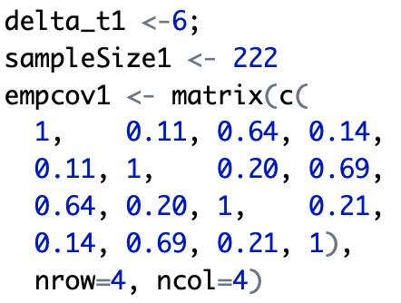
Continuous Time Meta-Analysis CoTiMA
When CoTiMA is useful
.64
JS_{t0}
JS_{t1}
.14
.11
.21
.20
JP_{t0}
.69
JP_{t1}
Notes:
There are two further information we need for conducting a CoTiMA.
One thing is the time interval or time lag between the measurement points.
In the study by Ashforth and Saks, the new employees participated four months after they started their jobs and once again 10 months after they started their jobs. So the time lag is 6 months.
And the final thing require for CoTiMA is the sample size of each primary study. In this case, we note N is 222, even job performance data at Time 1 were missing for one participant.
To give you an outlook what you would have to do in R to do a CoTiMA, this is it:
One has to store the time lag in a so-called object with the name delta_t1. For the second primary study this would be delta_t2 and so forth.
The the sample size has to be stored in an object called sampleSize1.
And finally, the correlation matrix from our figure has to be stored in an object called empcov1, which is essentially a matrix with four rows and four columns.
Of course, for any meta-analysis you would need more than a single study. Thus, you redo this for all primary studies that you could identify. And the you simply press “run”.
However, before we go into detail, the next couple of slides show how to install R and another program called R-Studio, and we explain some essentials of R and R-Studio.
You could directly move forward to slide number XX if your already know how to run a script in R.

Slide 6
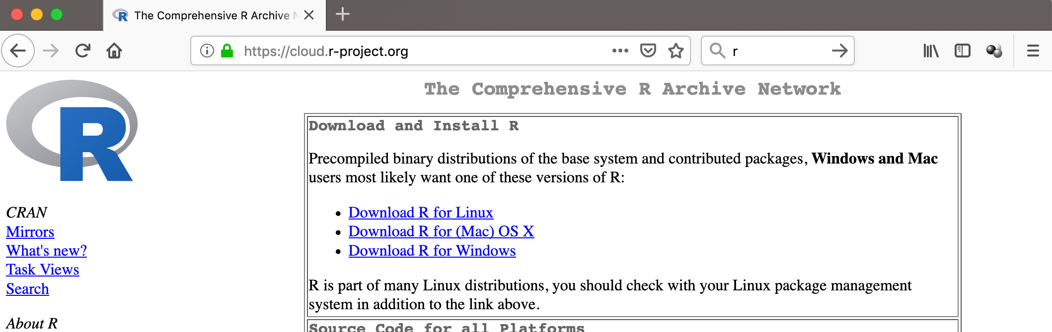
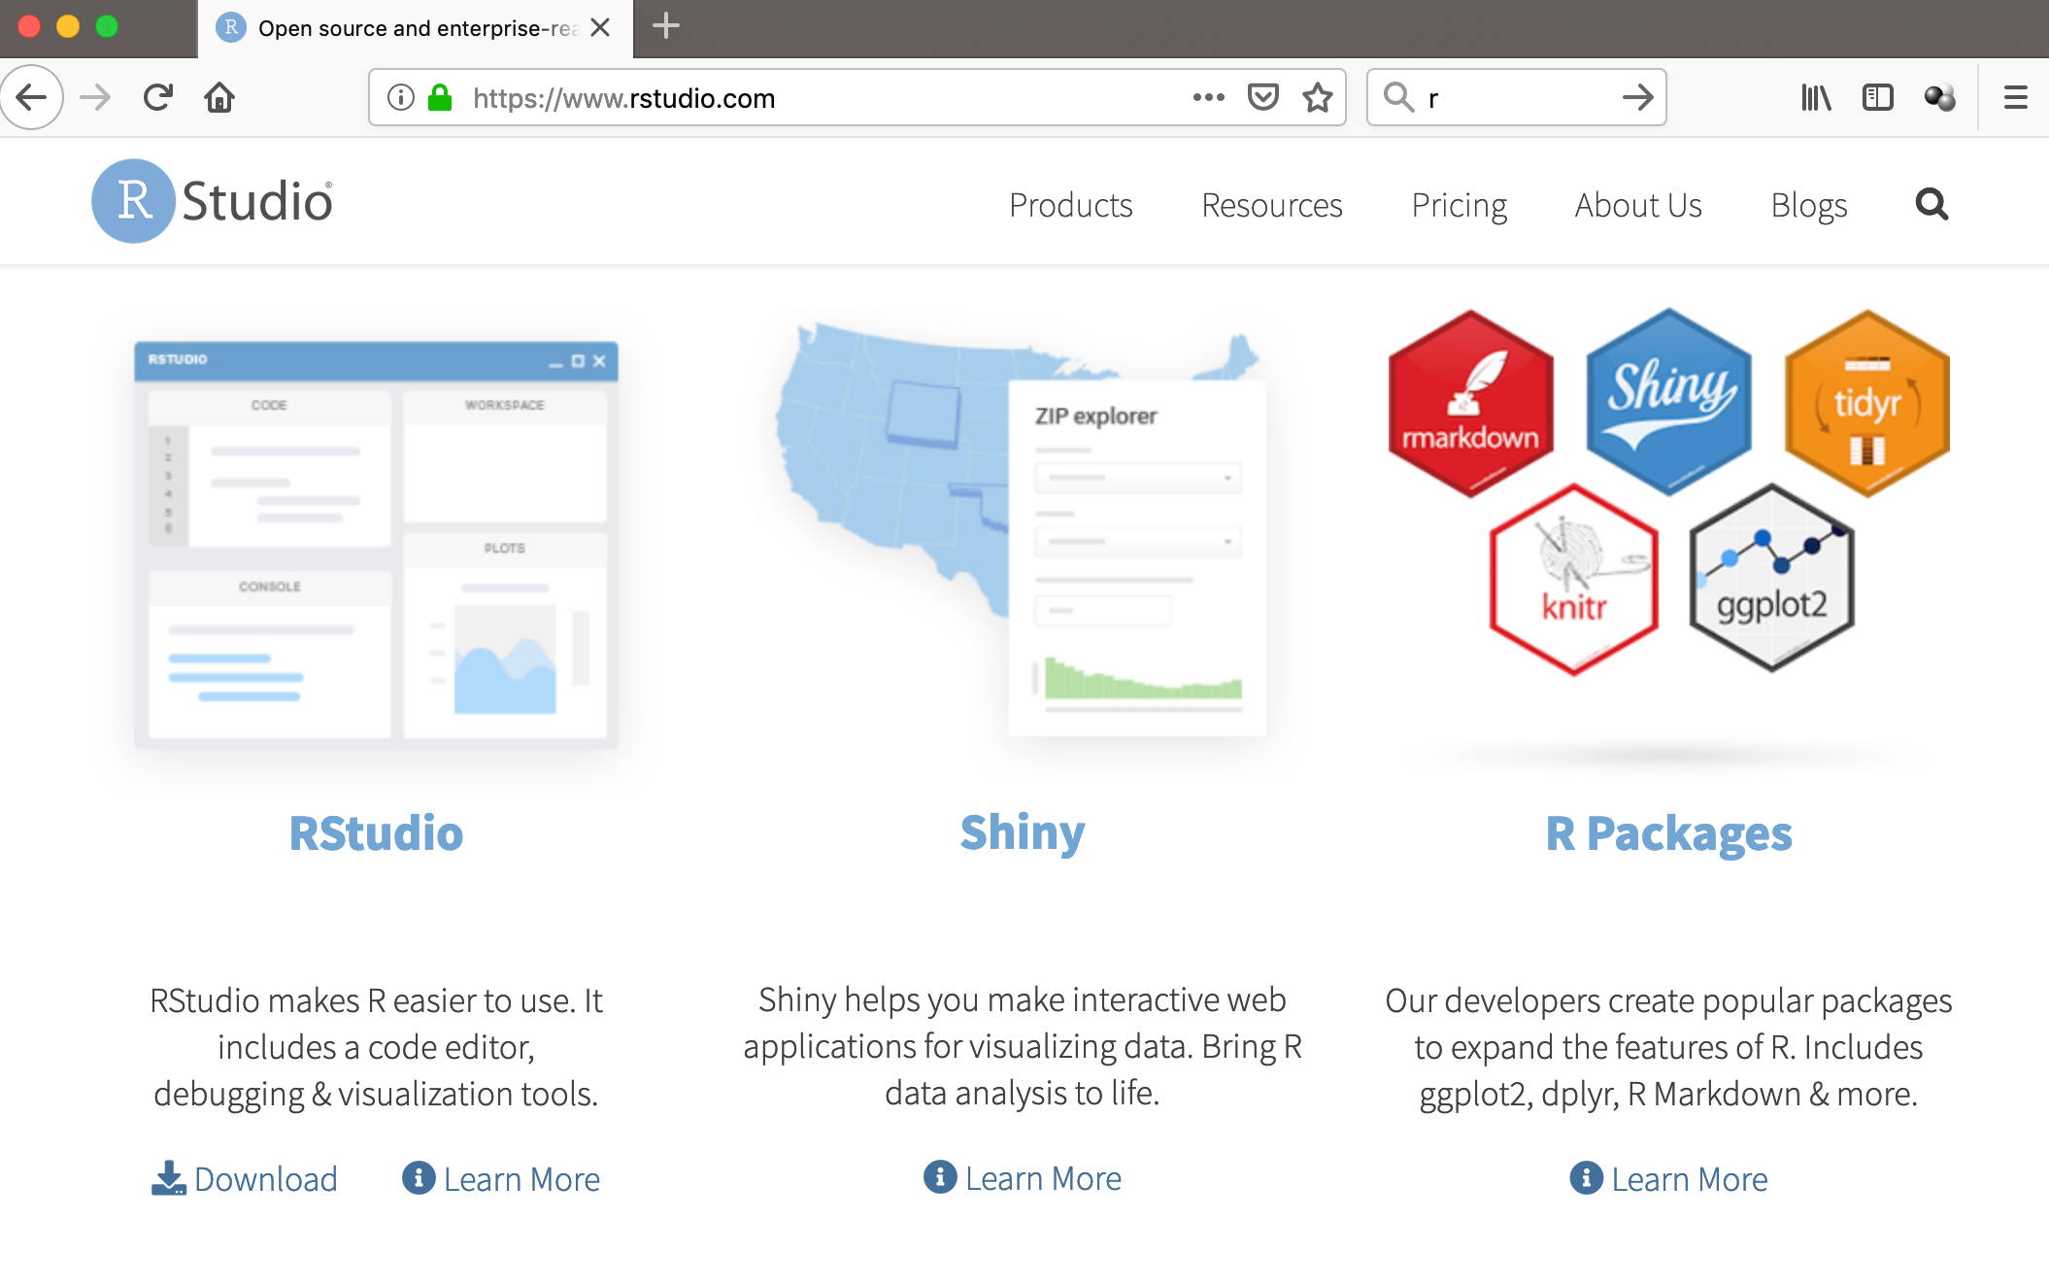
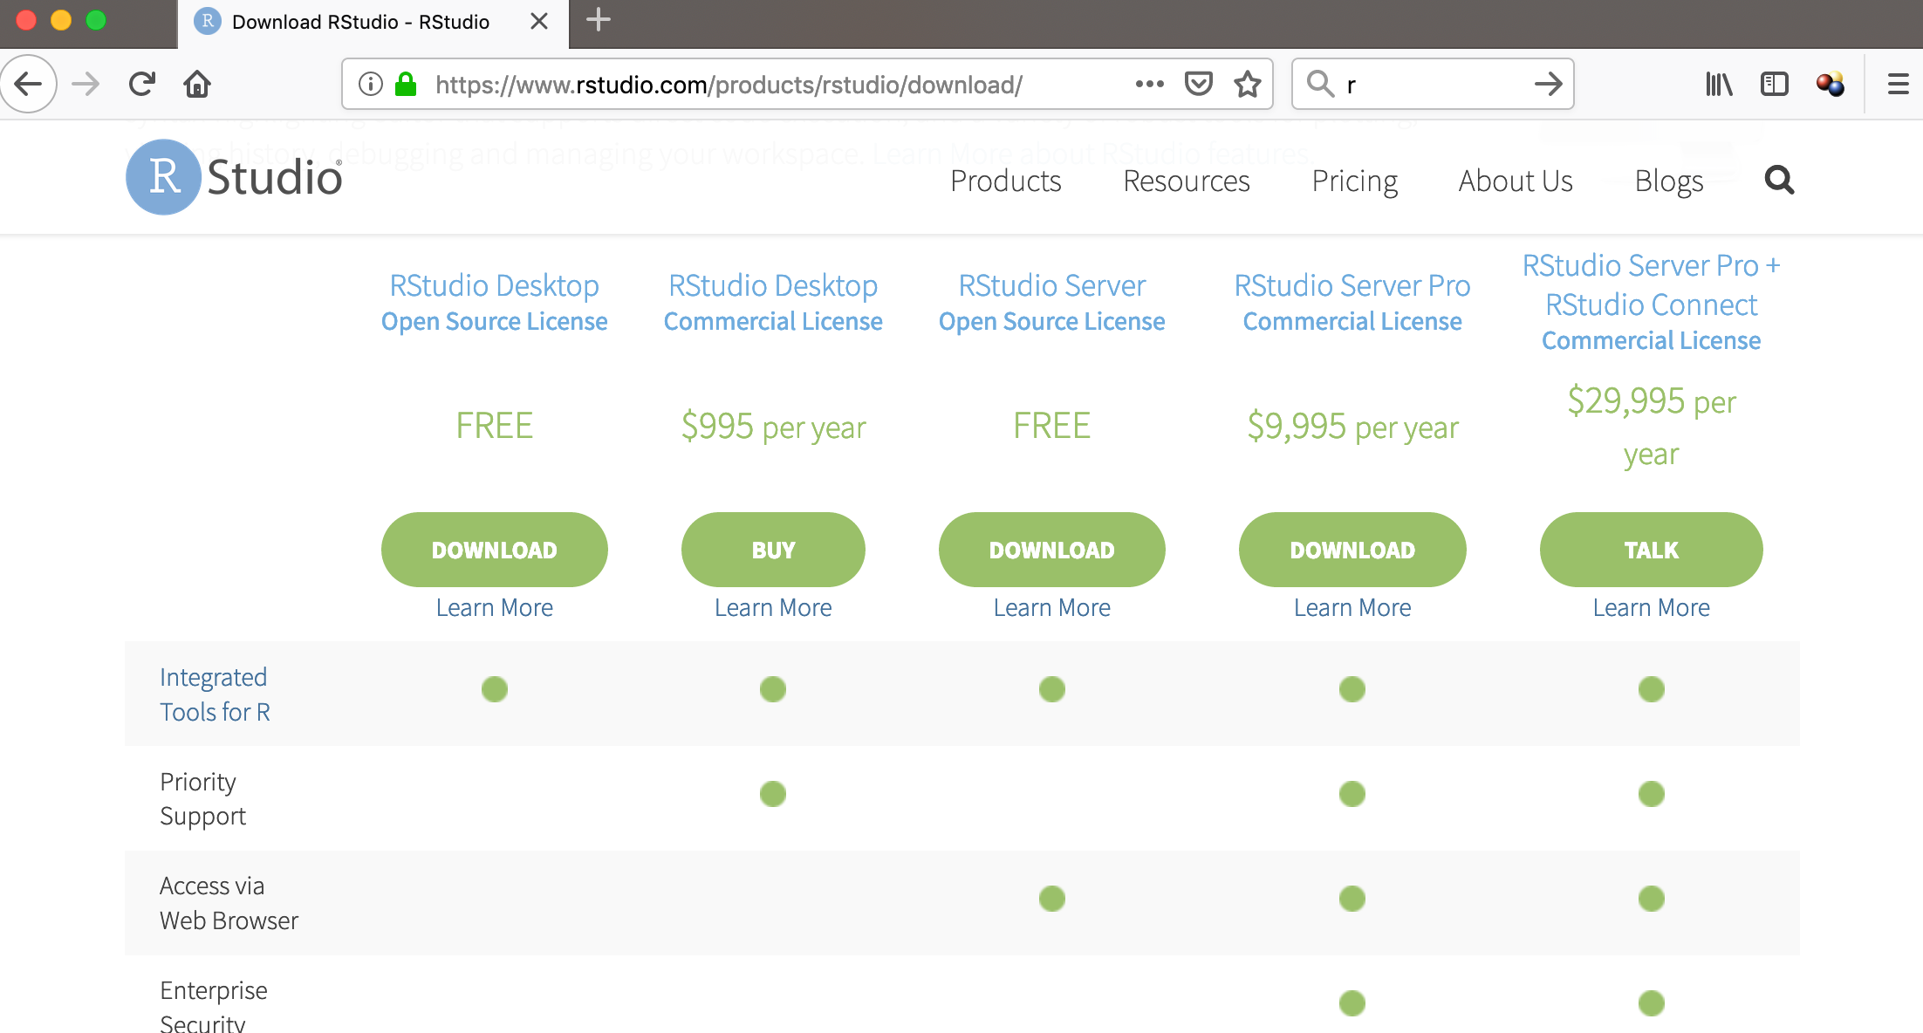
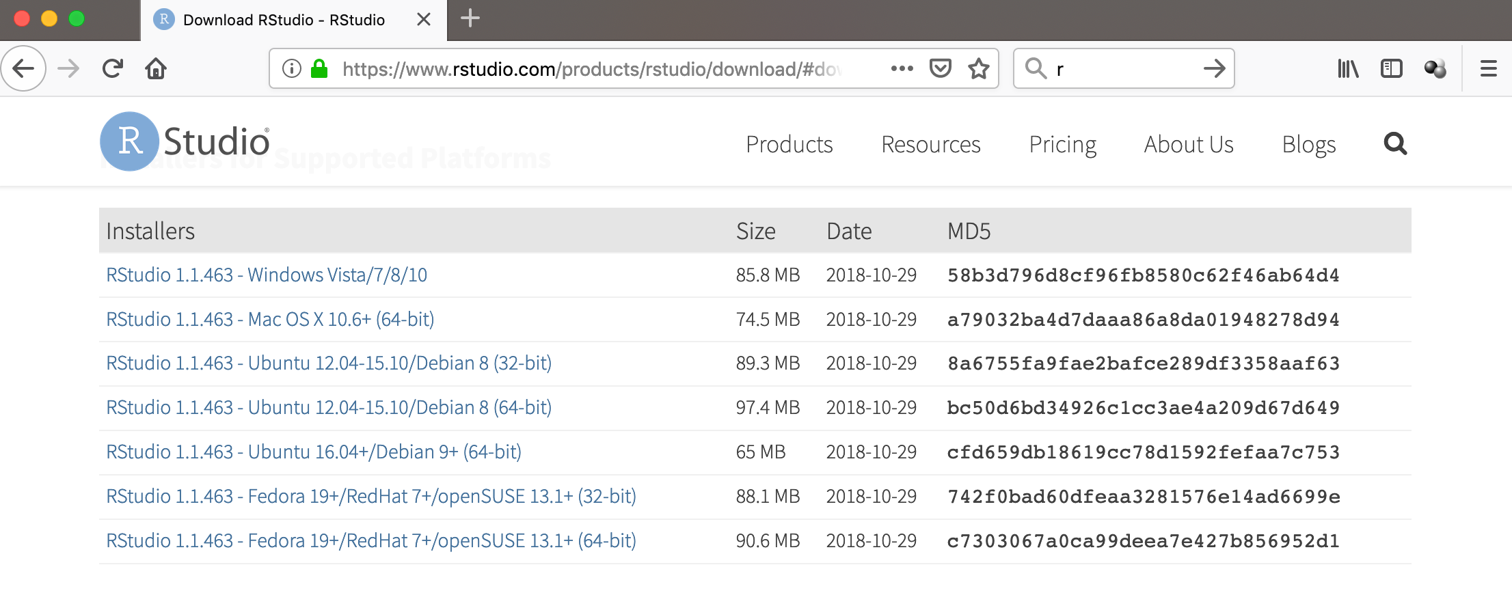
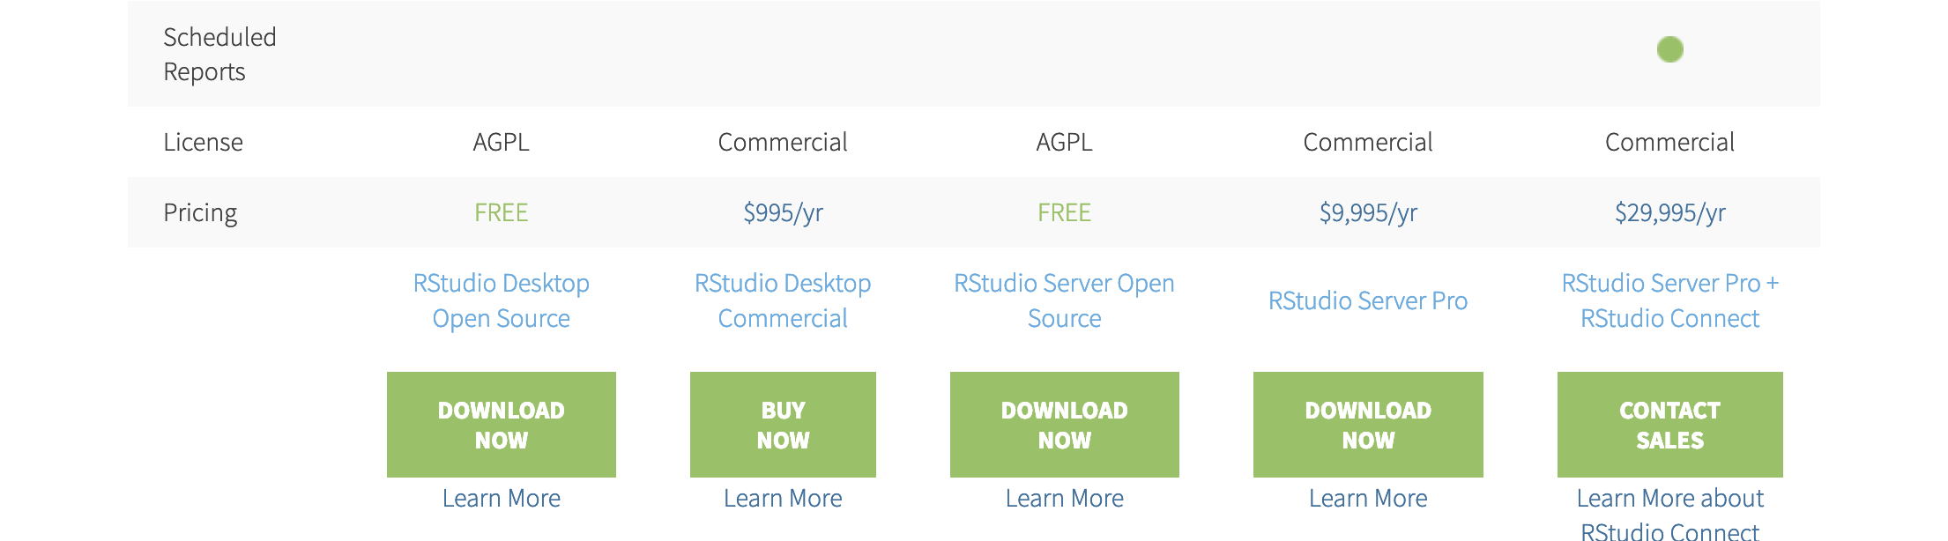
Continuous Time Meta-Analysis CoTiMA
Installation of R and R-Studio
Notes:
Before you could do a CoTiMA, you have to install the statistical software R on your computer. R is available for free.
=> The most simple way to get R is visiting the secure website httpS://cloud.r-project.org/
R is available for different operating systems. Just click on the appropriate one, download, and install.
After installation, there is no need to run R.
We recommend visiting the website of R-Studio, which is www.rstudio (without a dash).com
If you scroll down a bit, you will see that the Company behind R-Studio offers several products. Just click on R-Studio.
There are several versions of R-Studio available.
Just select the free version
This will guide you to another section on the website, where you have to select the appropriate operating system.
Just download the program and then install it. We recommend accepting all default values.
Finally, start R-Studio on your computer.

Slide 7
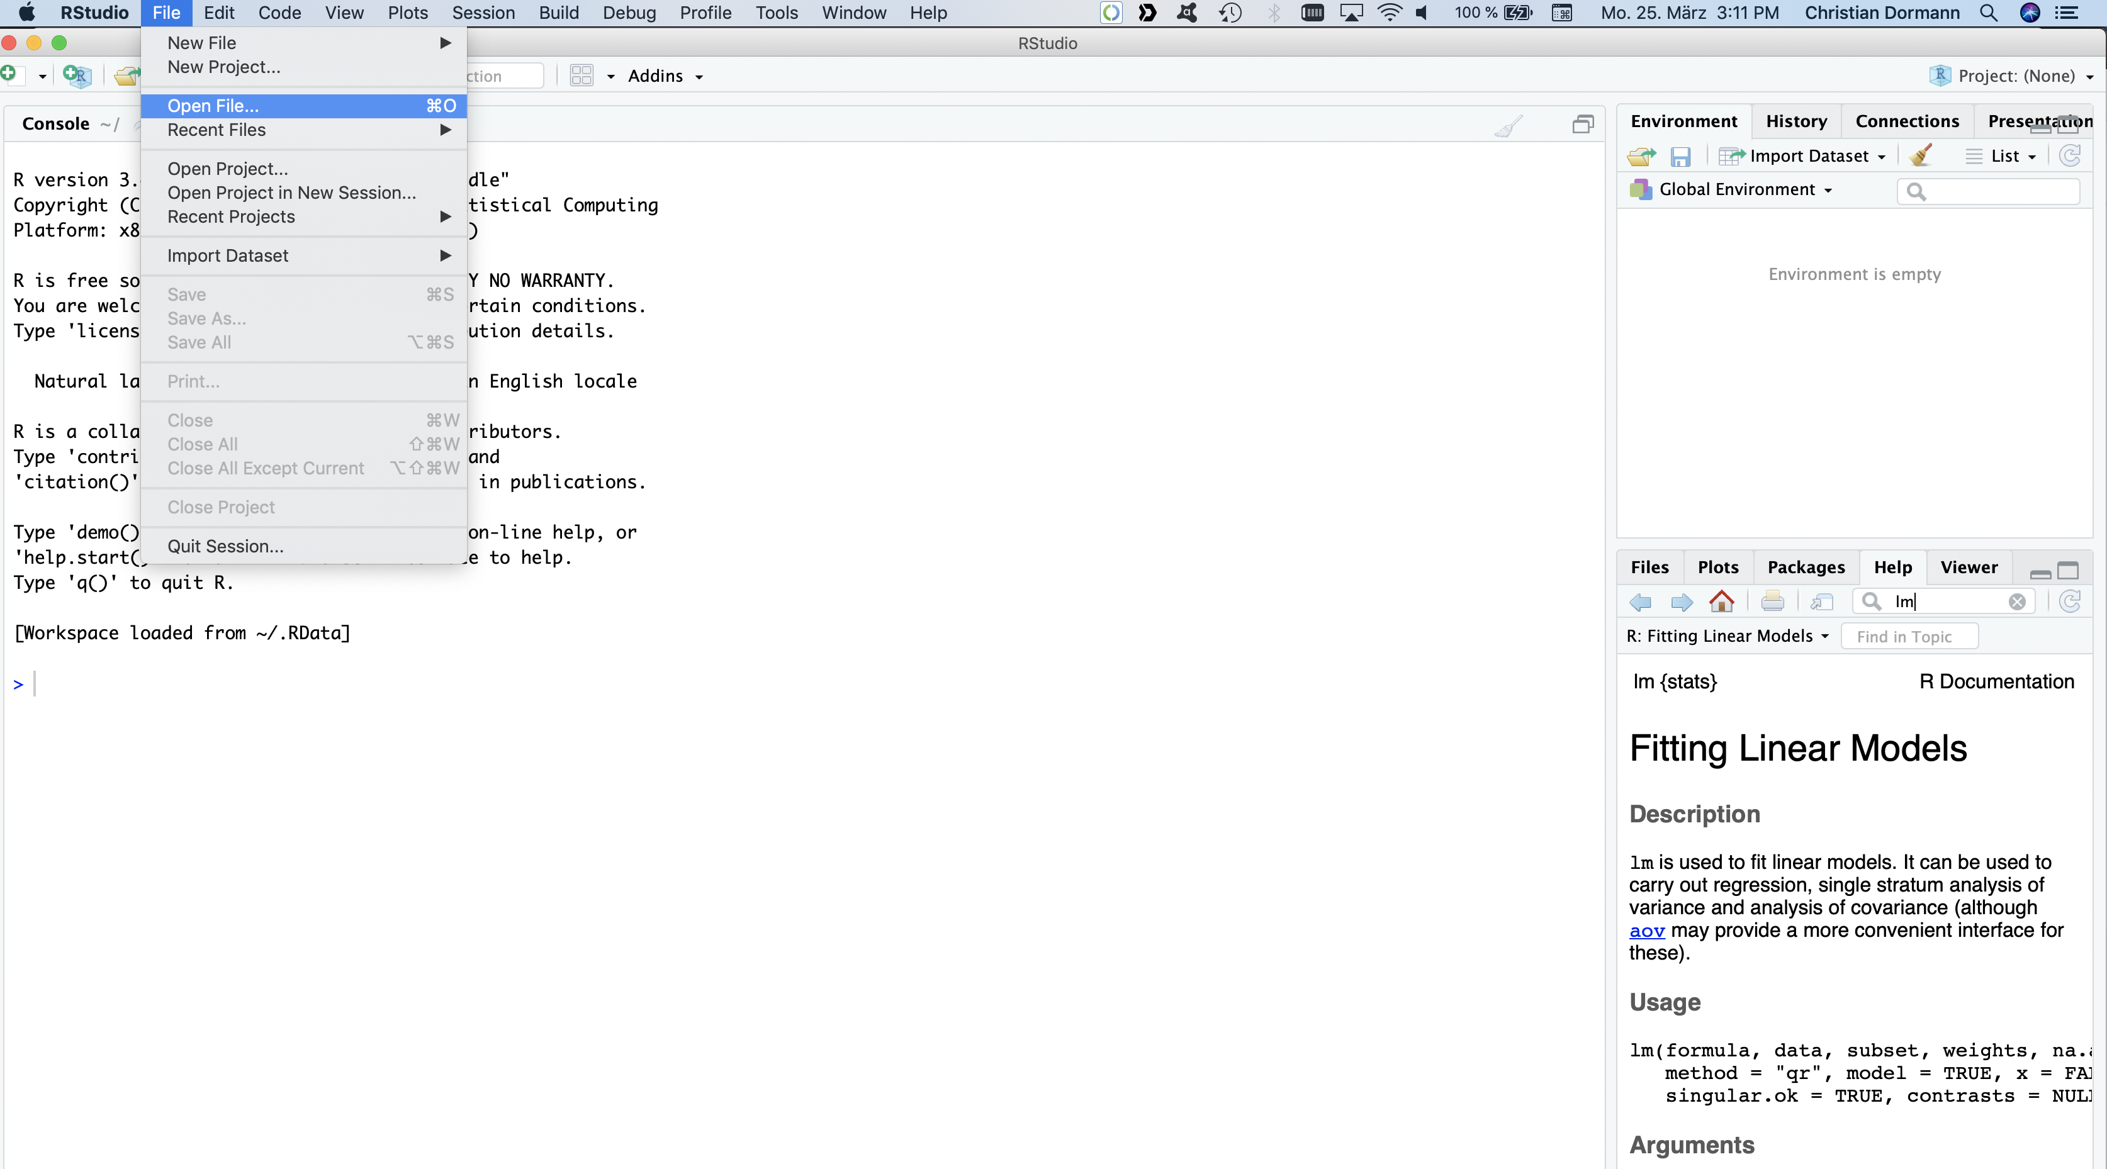
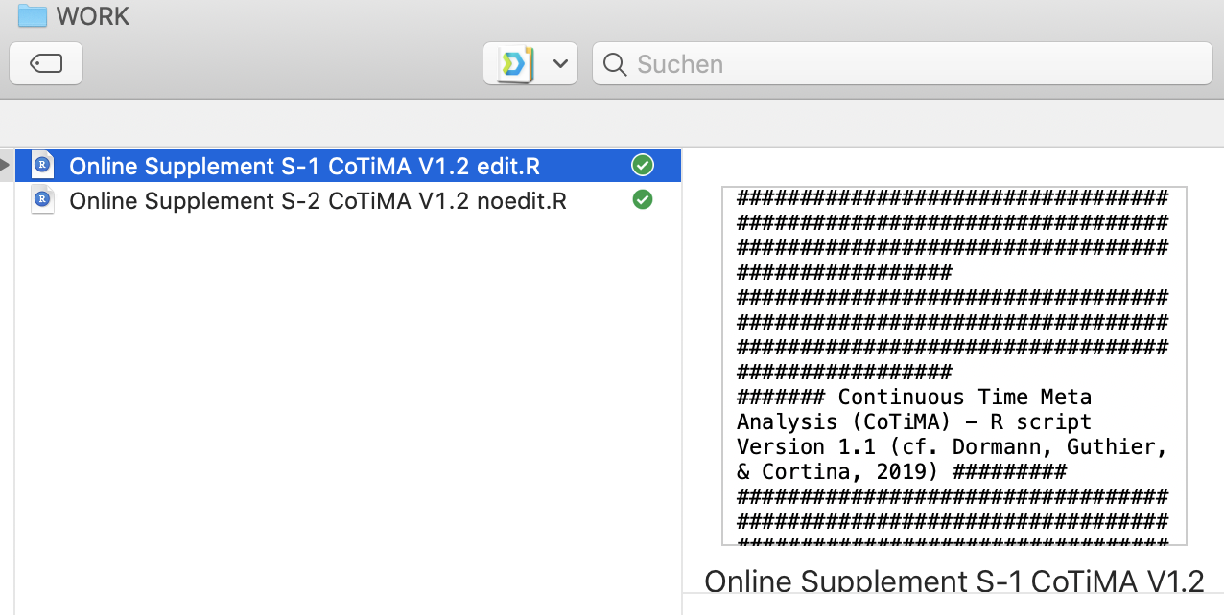
Continuous Time Meta-Analysis CoTiMA
Installation of R and R-Studio
Notes:
The next thing to do is to load to correct R-script.
Like SPSS Syntax and the code used in other statistical programs, R-code or R-scripts could be saved in files and then loaded again.
Unlike SPSS and other programs, in which you could modify data and request statistical tests in the menu, R, however, does everything by using commands in scripts.
Luckily, you will not have to learn any R code, but we explain a bit of this quite complex screen in a minute.
We provided two R-scripts as supplementary online material to the article by Dormann, Guthier & Cortina in Organizational Research Methods. You could them on the ORM webpage. Alternatively, you could also get them from www.applied-psychology.com.
To load a R-script, just click on the file menu, then select open file, …
And then click your way through to the directory on your computer where you have saved these files.
Both files have to be in the same directory. But you only have to open the “edit” file, which is highlighted in blue here, and leave the “noedit” file untouched.

Slide 8
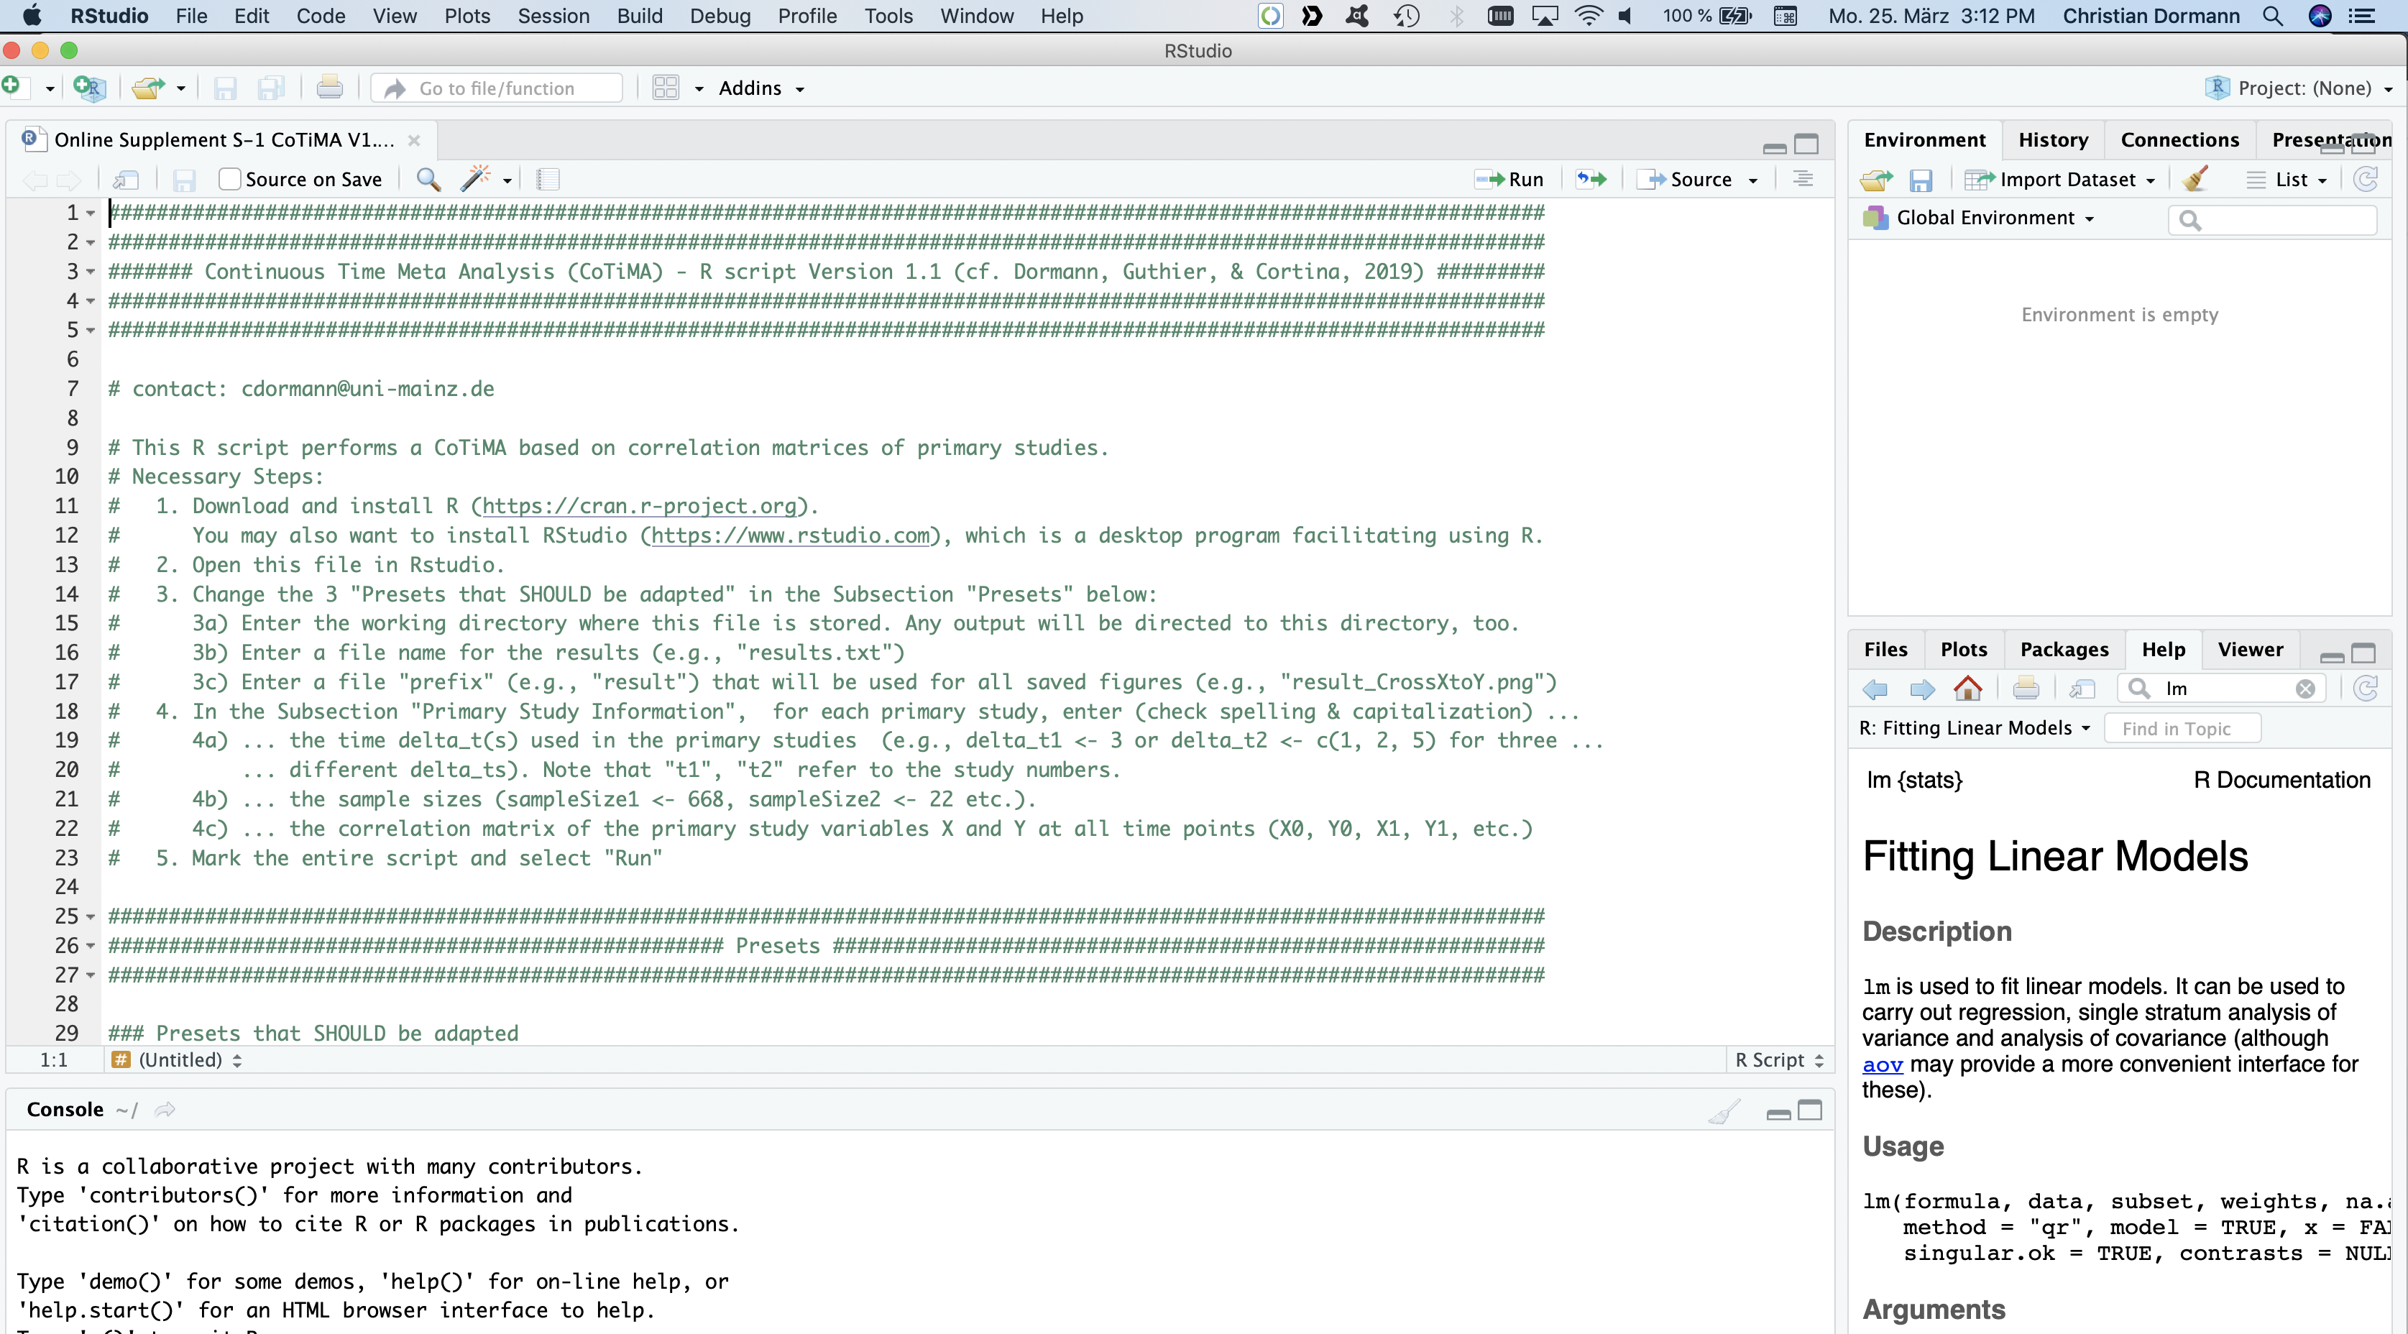
Continuous Time Meta-Analysis CoTiMA
Data Input
Notes:
The Window of R-Studio is usually partitioned into 4 areas or panes as they are called.
The top left pane is called the “Source”.
The Source pane is essentially a text editor. This is where R-code can be written and saved into a file.
The bottom left pane is called the “Console.”
In the Console, messages are displayed, code that is run from the source pane is repeated here, and the results of statistical tests are presented. You don’t have to worry that all CoTiMA results are presented in this small pane. They are also saved in an extra file where you can easily read them.
=> The name of the pane at the bottom right is just the list of menu entries: “Files, Plots, Packages etc”
You will not have to use it. However, as an example, we have selected the Help menu here. Then we have searched for ”lm”. As you can see, the help page shows than lm is useful for fitting linear models such as regression analysis. Much more would be shown if you scroll down.
Finally, the name of the pane at the top right again is just a list of the menu names: Environment, History etc.
The main thing in this pane that you may probably have to use in the “brush” button in the Environment menu.
Pressing the brush button is like going-back-to-square-one. For example, if you get confused which code you have actually executed and in which order, it might be a good idea to go back to square 1 and re-start your analysis from scratch.
This brief introduction should be sufficient to understand what we do next. What we do next is – conducting a CoTiMA.

Slide 9
Continuous Time Meta-Analysis CoTiMA
Data Input
Notes:
The top of the CoTiMA-edit-script is just a summary of the steps required to conduct a CoTiMA.
R treats everything to the right side of a hashtag as a comment, so nothing really happens here.
Let’s go briefly through the comments.
For a CoTiMA, you have to download and install R and RStudio
This is what we already did.
The second step is to open this file in Rstudio.
We also did this already. So 2 out of 5 Steps are already done.
=> The third step is to change the three "Presets that SHOULD be adapted" in the Subsection "Presets" below
In fact, in a minute we will (a) enter a working directory, (b) enter a file name to save our results in, and we will (c) provide a file "prefix" that will be used to label all saved figures.
=> The fourth step, which we will do in two minutes, is entering the relevant information of the primary studies, that is the length of the time lags used, the sample sizes of the primary studies, and the correlation matrices we extracted from the descriptive statistics table of the primary studies.
Finally, the fifth step is to mark the entire script and select "Run”.
Actually, there is an optional step in between Step 4 and Step 5, which we will also show. In this optional step, you could change some default values for CoTiMA. But for today, there is no real need to change any of the defaults.

Slide 10
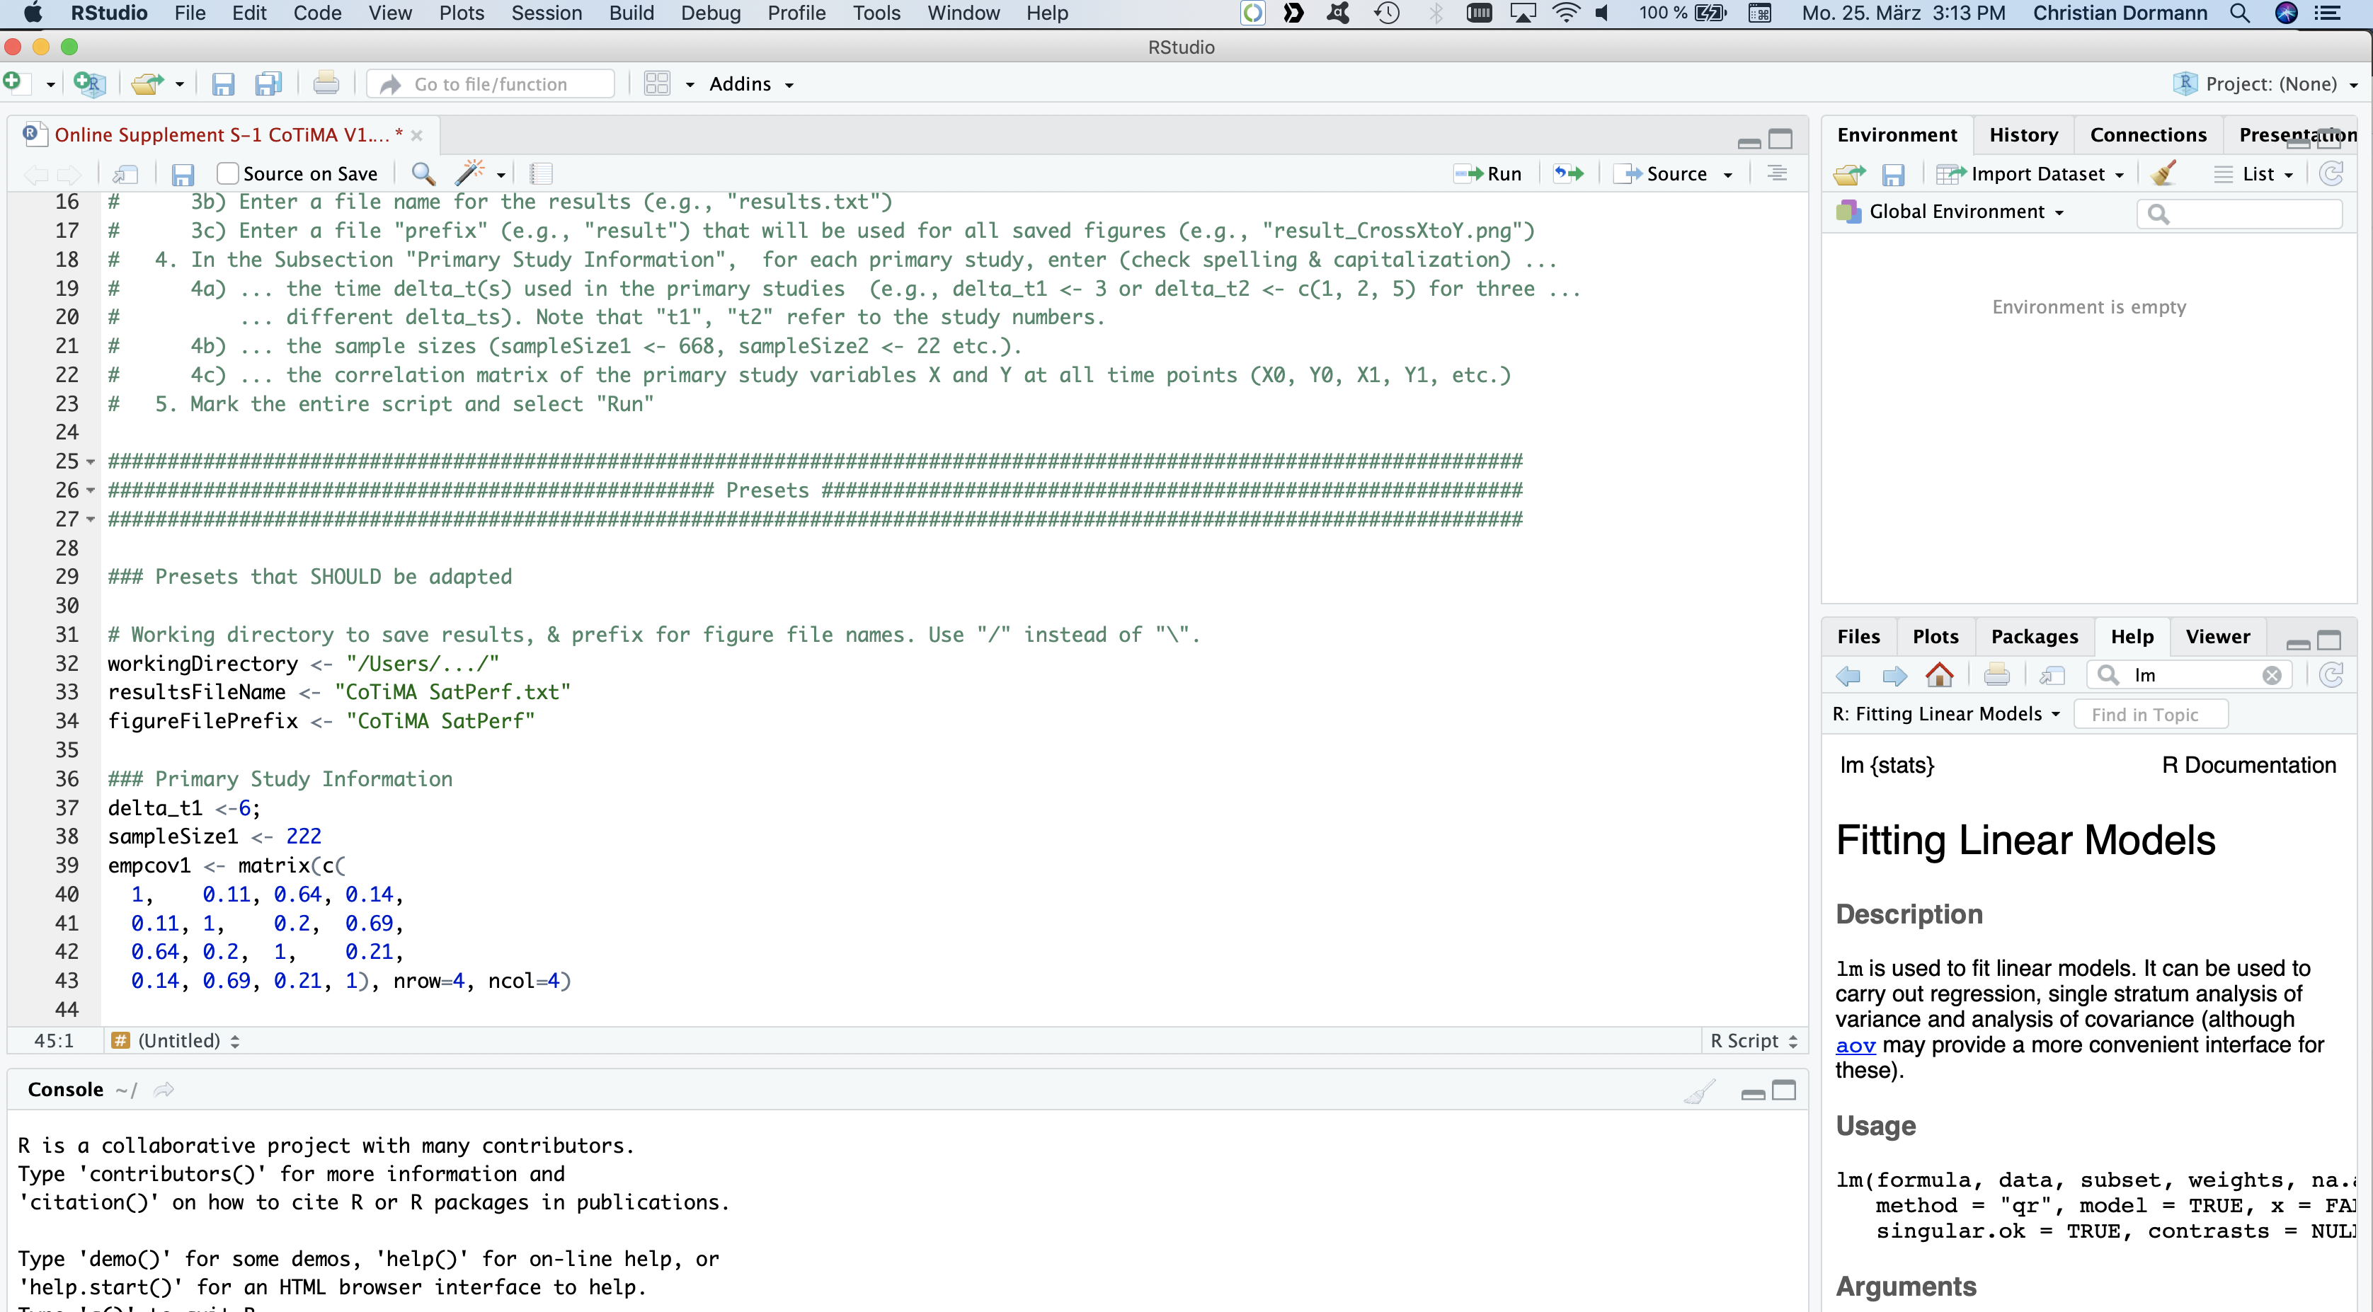
Continuous Time Meta-Analysis CoTiMA
Data Input
CoTiMA SatPerf_CoTiMA results for auto-regressive effects of V2.png
Notes:
Okay, let’s have a look at the presets that should be adapted.
First, we have to specify the path to the working directory. On Mac computers, the path typically starts with “Slash – Users – Slash”.
On Windows computers the paths typically start with “C-Colon-Backslash”.
However, even on a Windows mashine one should use slashes instead of backslashes.
=> Next, we specify the name of the file where the CoTiMA results will be saved.
Then we have to provide a prefix that will be used for labeling the files in which the automatically created figures are saved.
=> If we specify the prefix as “CoTiMA SatPer”, files with names like this one will be created.
They all begin with CoTiMA SatPer, which is highlighted in red here.
=> And finally, we have to enter the relevant information of the primary studies that should be meta-analyzed.
Recall this were the time lags, which in this case means delta_t1 equals 6, sampleSize1 equals 222, and the correlation matrix empcov1.
You may have noted that in order to assign values to an object, like the value 6 to the object delta_t1, the combination of a less-than sign followed be a minus sign rather then an equals sign is used.

Slide 11
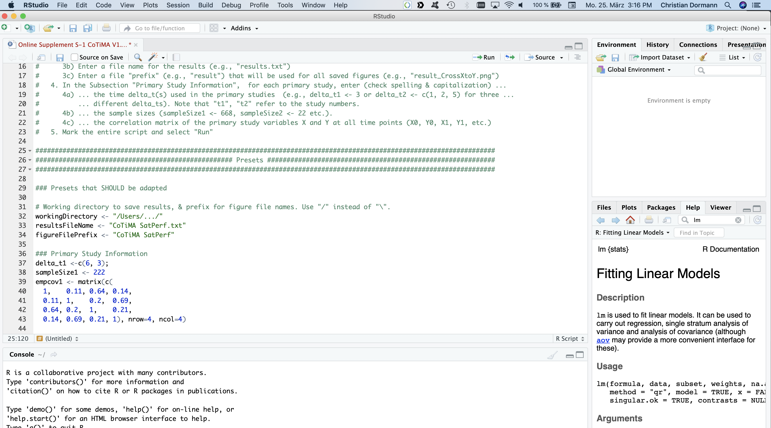
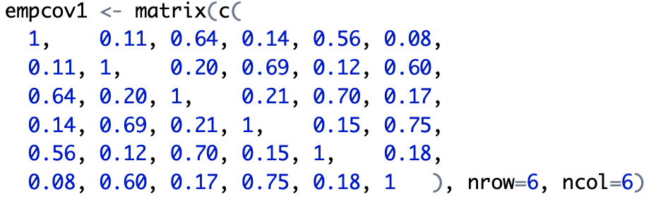
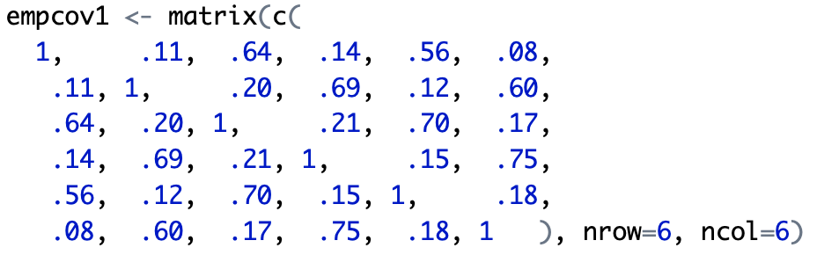
Continuous Time Meta-Analysis CoTiMA
Data Input
Notes:
I like the idea of telling about more than 2 wave studies. I think, it would be better, to somehow highlight on the slide before that this primary study is an example for a two wave study and then talk about the changes that need to be made when there are more then 2 waves – delta_ and empcov and I think it is absolutely necessary to actually show a 6*6 correlations matrix.
=> Some primary studies have more than two waves.
In such cases, there is more than a single time lag, and the time lags have to be provided as a so-called column-vector.
A column vector starts with a c, and then the time lags follow in brackets separated by commas.
In this case, the primary study would have had 3 waves of data. The first two waves were separated by 6 months, and the second and third wave were separated by 3 months.
Recall that the time lag could be provided in any unit you prefer. It could be in years, months, weeks, days or whatever. However, you should use the selected unit of time consistently within a CoTiMA.
Of course, if a primary study had 3 waves of data, the correlation matrix would be larger.
In this case, it would be a matrix with 6 rows and six columns.
By the way, in R you could also specify values without leading zeros.
For a CoTiMA, the number of measurement occasions could vary across primary studies, and the time lags could also vary within and between studies.
This is one of the large benefits of CoTiMA compared to other types of meta-analyses of longitudinal data. CoTiMA uses all available correlations, and it uses information about the interval between the measurements. You just have to provide time lags in the form of a column vector instead of a single value, and you have to provide larger correlation matrices. That’s it.
=> However, in this tutorial we consider only primary studies with two waves. This keeps the slides a bit smaller and it does not have any impact on the output files and the figures created by CoTiMA.

Slide 12
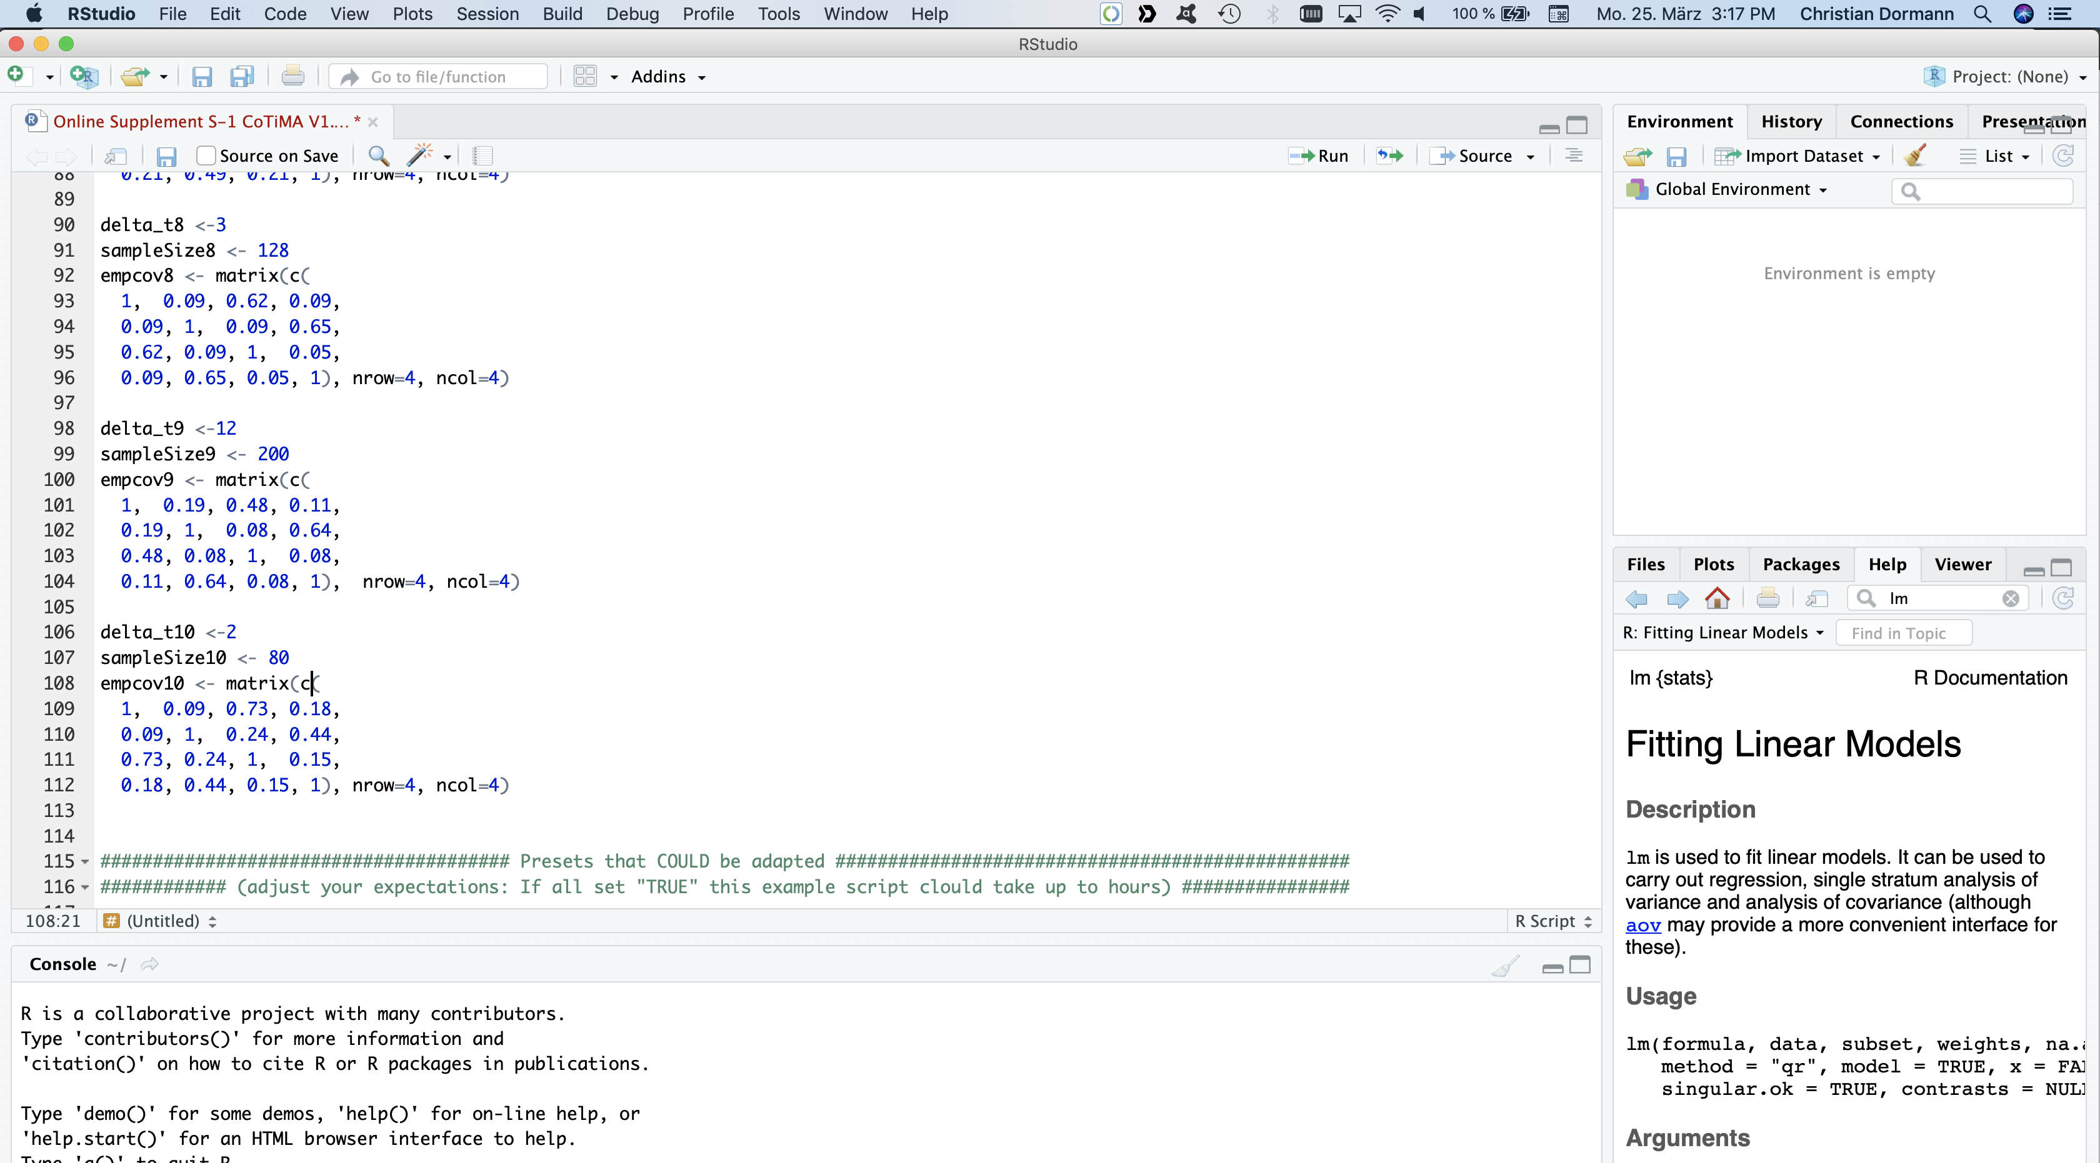
Continuous Time Meta-Analysis CoTiMA
Data Input
Notes:
If we move further down in the source pane, we see that in our example we have ten primary studies.
When you conduct your first own CoTiMA, we recommend that you start with two or three primary studies.
This reduces computation times and possible slips and errors in your script are easier to tackle.
Then you could add further studies and so fourth.
Sometimes, a single primary causes estimation problems. Indeed, here and then we found errors in the correlation tables of primary studies, such as missing minus signs or wrong numbers. This is probably the major cause for estimation problems and in such instance you may want to exclude a particular primary study from CoTiMA.
The reason why we use ten primary studies here is because these are the same primary studies as in the Organizational Research Methods article by Dormann, Guthier and Cortina.
Thus, when we come to the interpretation of results later, you could also consult their article.
After you entered the information from the last primary study, you could run the scrip as we show later.
=> Before we do so, however, we will guide you briefly through an optional step, in which you could, but you do not have to, make adaptations to some further presets.

Slide 13
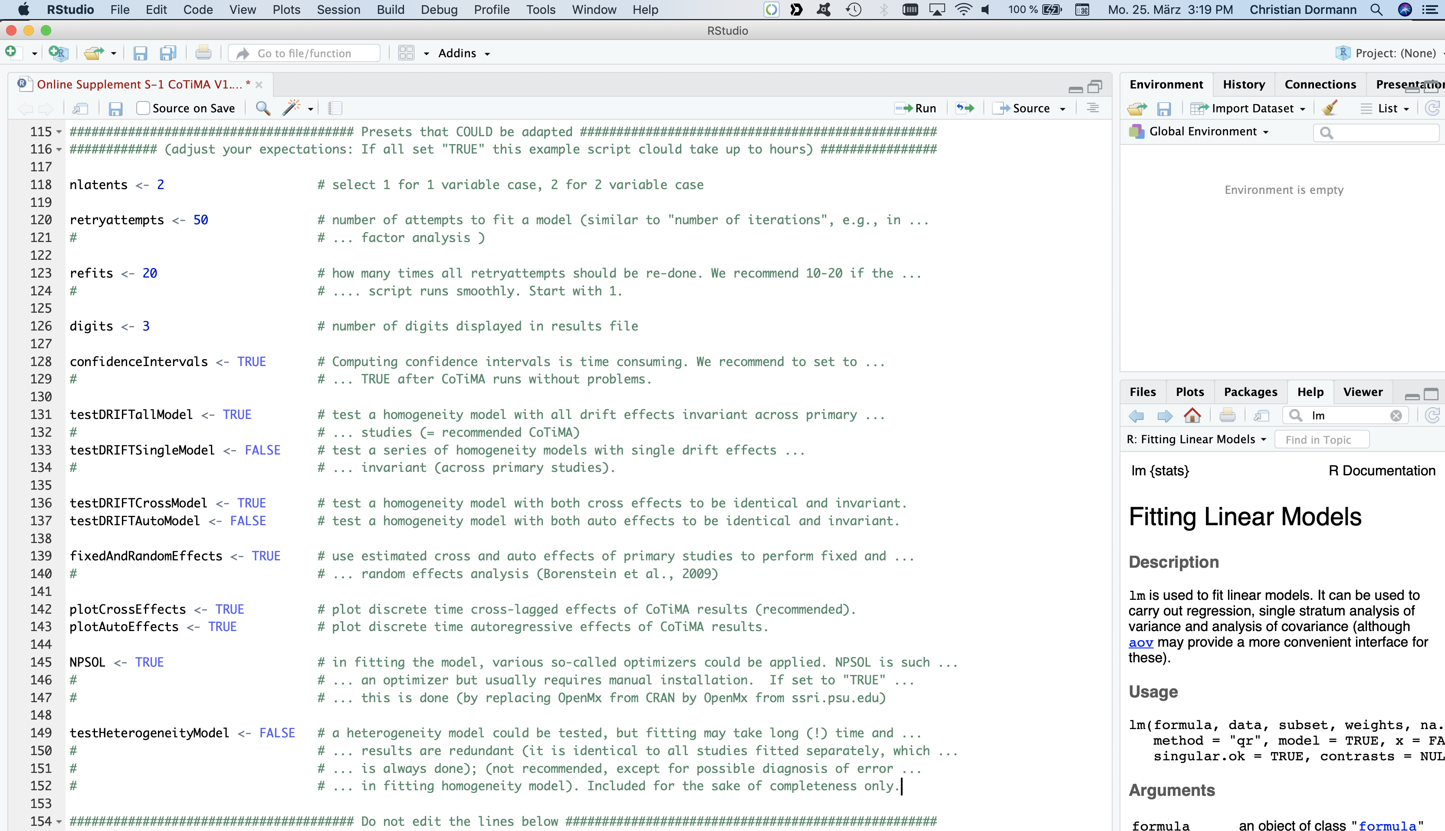
Continuous Time Meta-Analysis CoTiMA
Data Input
Notes:
=> The first option refers to the number of variables analyzed.
By convention, the variable are called latent variables even if they are not latent in terms of a measurement model a used in confirmatory factor analysis.
In our case of the relation between job satisfaction and job performance, and in probably most other cases, we have two variables.
You could also change the number of retry-attempts. retry-attempts is just another term for “number of iterations”
You might know that the maximum number of iterations could also be adapted in many structural equation computer programs or in factor analysis, for example, in SPSS.
However, fifty should be okay on most instances.
=>The number of refits, which is set to 20 by default, specifies how frequently a model is estimated.
You may wonder why each model should be estimated 20 times. Why, for example, should one perform a t-test 20 times? The reason is that each model estimation has a random component in how the model fit is improved. Futher, computer programs use algorithms to fit models to data, and when new software versions are provided, these algorithms might change a bit, too. In most instances, this finally leads to the same solution. This is why we recommend you set this value to 1.0 when doing your own CoTiMA.
However, we have been working with this example for several years. And we encountered slight variations in the results over the years and across different operating systems. Although these were very minor differences, we want to make sure that you get the same results aas we do in this tutorial when running the same scripts on your computer. This is why we set the value to 20 here.
So you may start with setting the number of refits to 1, but before you submit your paper to a journal give it a finaly try with a larger number of refits such as 20 or even 40 or 50.

Slide 14
Continuous Time Meta-Analysis CoTiMA
Data Input
Notes:
The next option refers to the number of digits used in the output file.
By convention, most journals require results to be displayed with 2 digits. However, in CoTiMA we sometimes deal with small effect or small differences between effects that are nevertheless significant because of large sample sizes. Therefore, 3 digits could be more appropriate than 2.
=> You could also request confidence intervals to be computed.
However, computing confidence intervals is time consuming. Usually, we recommend to initially set this to FALSE and later to TRUE after CoTiMA runs without problems. However, to explain all possible output in this tutorial we set it to TRUE.
=> The next option should always be set to TRUE.
This is the option that actually says that you want to conduct a CoTiMA. In structural equation modelling terms, a CoTiMA is a multi-sample homogeneity model in which with all drift effects, that is, all auto effects and all cross effects, are invariant across primary studies.
=> Instead of fixing everything invariant across primary studies, you could also separately do so for each auto effect and each cross effect.
This is done with this option, however, we leave it here as FALSE.
=> In several cross-lagged studies, researchers want to know if the two cross-lagged effects are identical or if one effect is larger than the other one.
This could also be doe in CoTiMA by setting this option to TRUE.
=> You could also request a test if the two auto effects are identical across studies, but this is rarely of much interest and so we leave this option as FALSE.
Basically, CoTIMA itself is a fixed effect approach because many parameters have to be estimated and the number of primary studies in most research areas is likely to be too small to for a random effects CoTiMA. However, for each single effect analyzed separately, one could apply a fixed and a random effects analysis. In the Organizational Research Methods article, we used the approach of Borenstein and colleagues.
=> To replicate the results published in our paper, we leave this option as TRUE
=> What you probably always want to get is a figure showing how cross-lagged effects unfold across time, which you get with this option set to TRUE.
=> What you probably rarely want is the same plots for autoregressive effects, but since we aim to show how this figures could be interpreted we leave it to TRUE.
=> The next point is a rather technical one.
Different so-called optimizers use in different estimation algorithms, which are mathematically quite complex. One of the best optimizers is NPSOL, but it does not come as a default optimizer when you have already installed certain R-packages before. Setting it to TRUE will get it for you then. But even if set to FALSE, you should get the same results.
Finally, we set the option testHeterogeneityModel to FALSE. The reason is that fitting may take long (!) time and the results are redundant anyway. We included this option for the sake of completeness only.
And: You better do not edit the lines below this point.

Slide 15
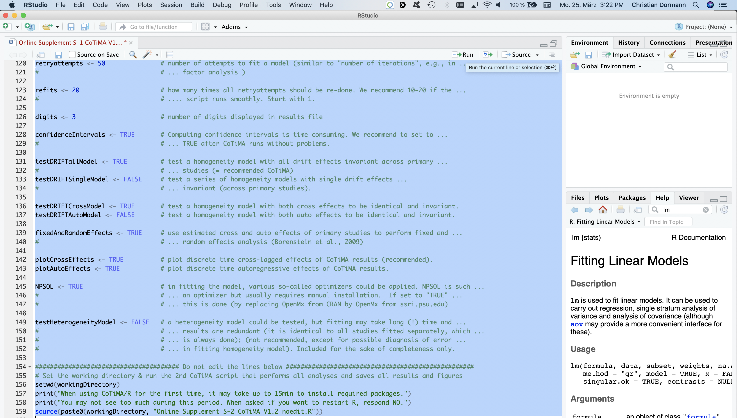
Continuous Time Meta-Analysis CoTiMA
Running
Notes:
Now all is done.
Simply mark the entire script in the source pane. On most computer systems this is achieved by pressing the Control Button and while holding it down then press A. Of course, you could also use the mouse.
=> Then press “Run”

Slide 16
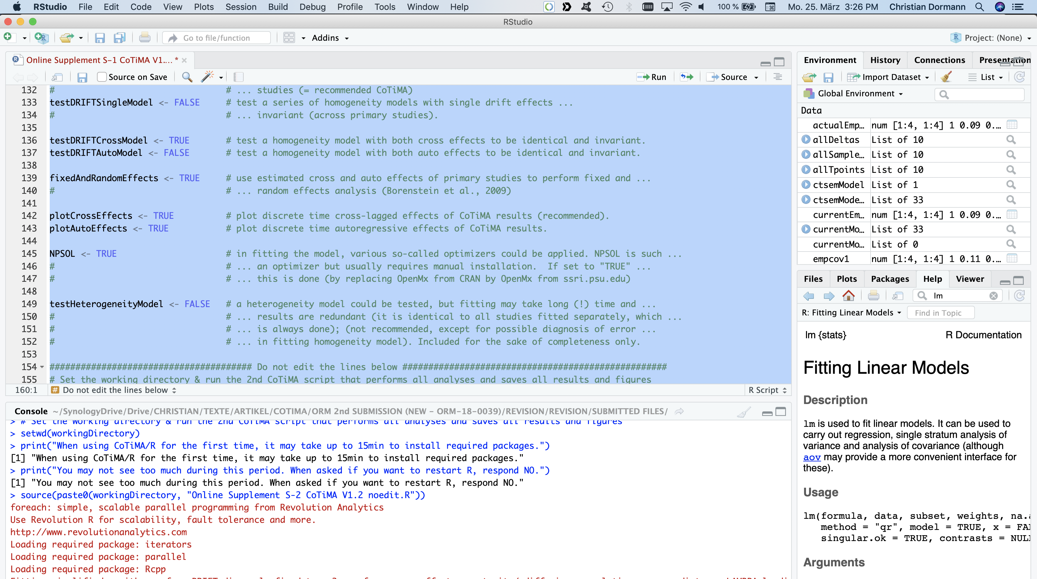
Continuous Time Meta-Analysis CoTiMA
Running
Notes:
Depending on whether you have used R and some packages, you may or may not see this text on your console.
It says that it may take some time to install the required packages.
It also says that if you are asked if you want to restart R before installing a package you should click NO.
=>Once the required packages are installed, they have to be loaded, which is another term for activating them or making their actual use possible.

Slide 17
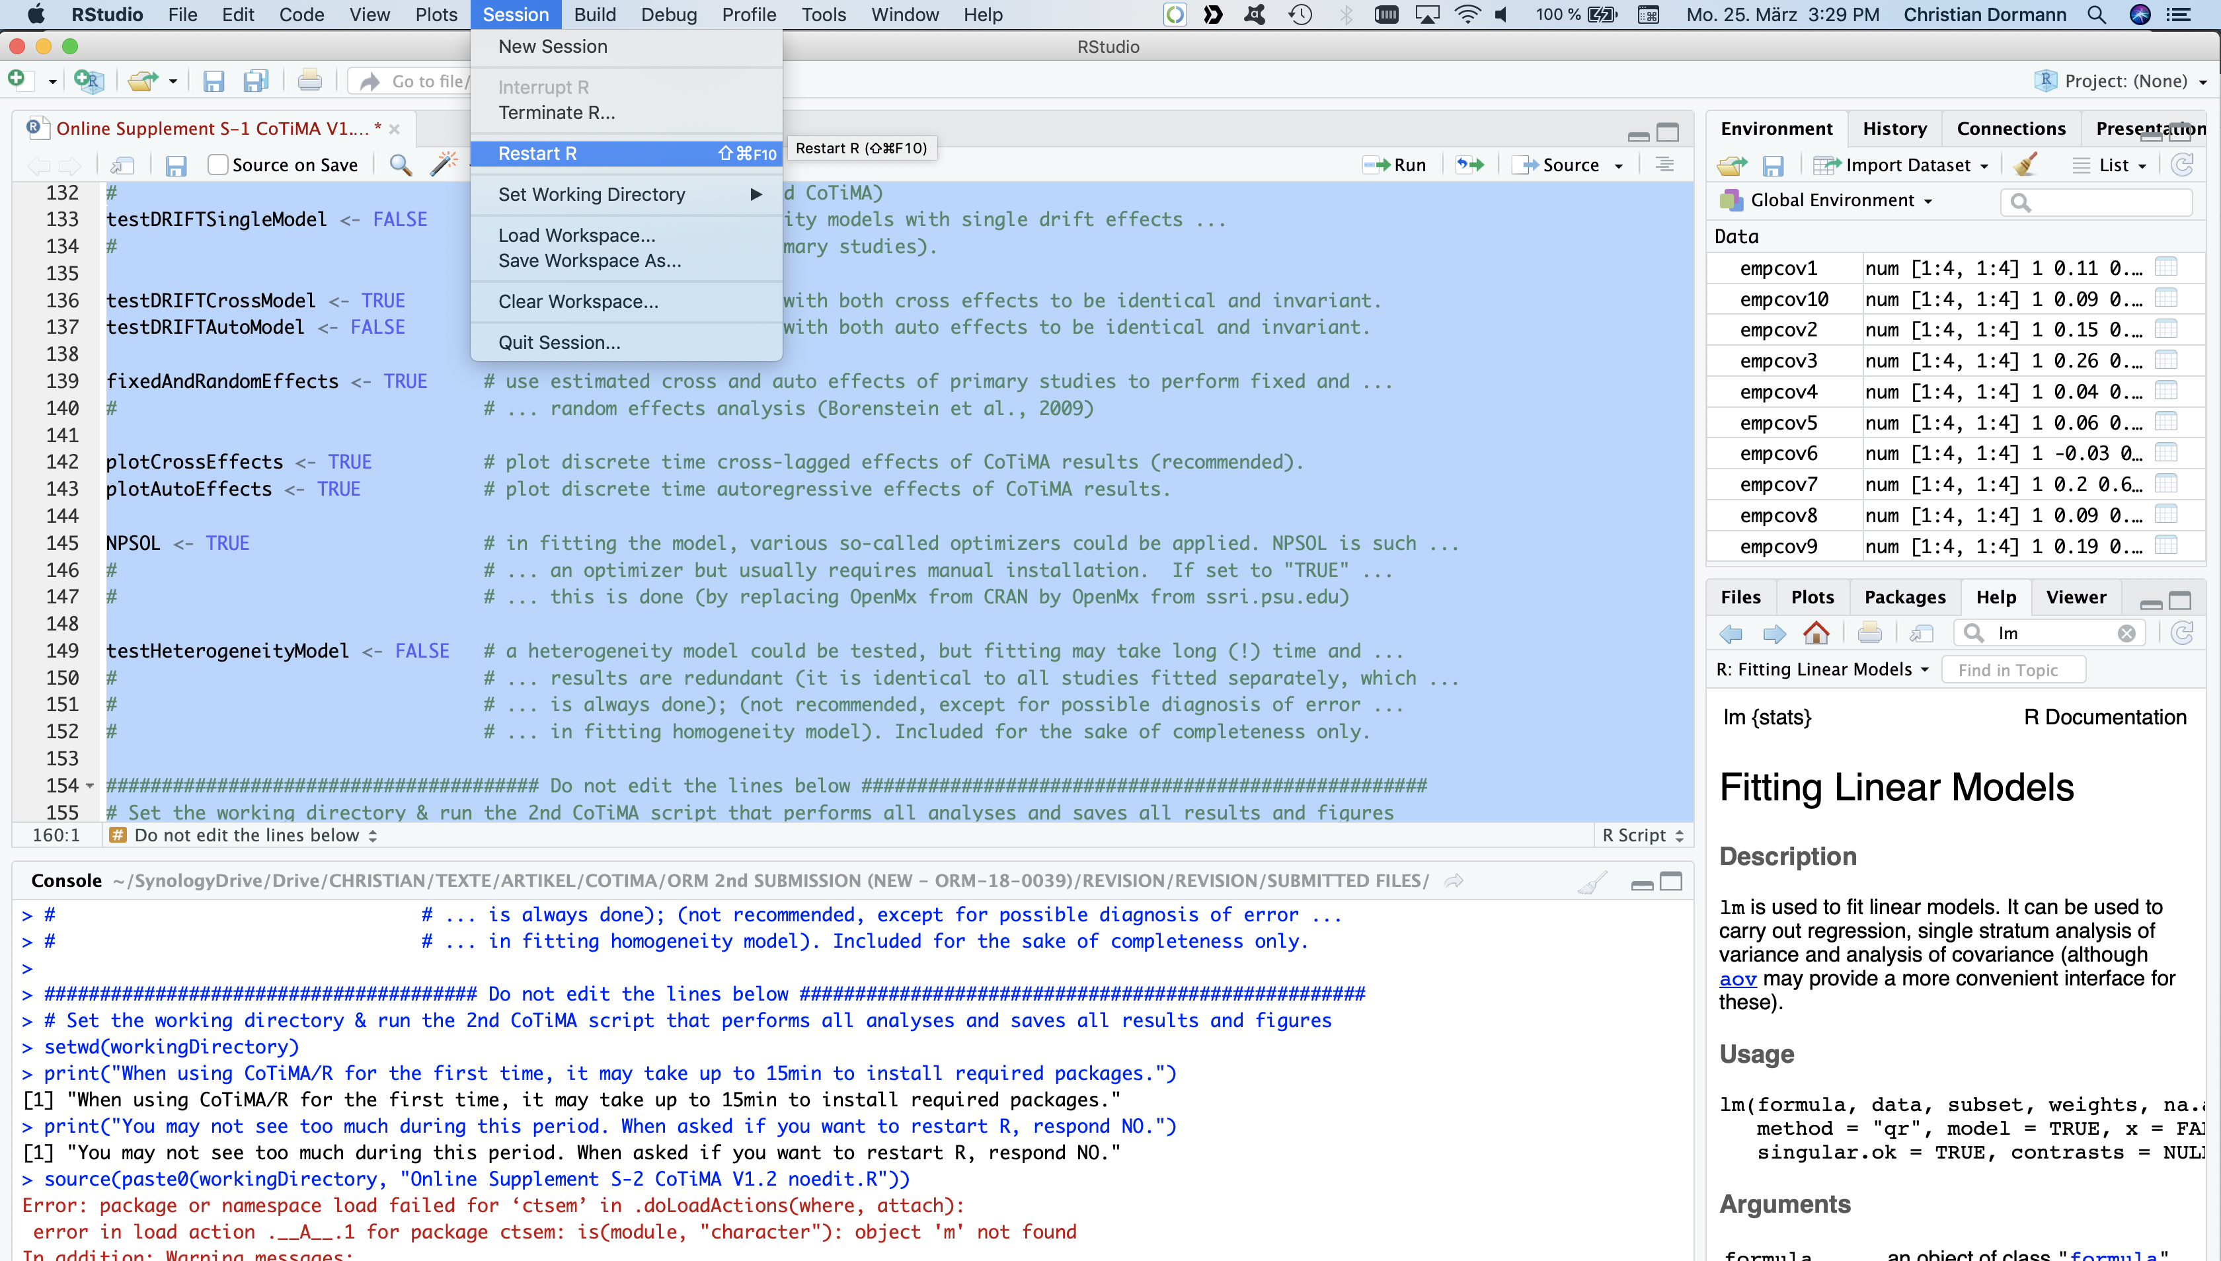
Continuous Time Meta-Analysis CoTiMA
Running
Notes:
=> For sure this will not happen if you just opened R-Studio on your computer, but it may happen here and then after re-doing a CoTiMA and trying to re-actívate packages.
If you see this error messarge, just select the “Restart R” option from the Session manu.

Slide 18
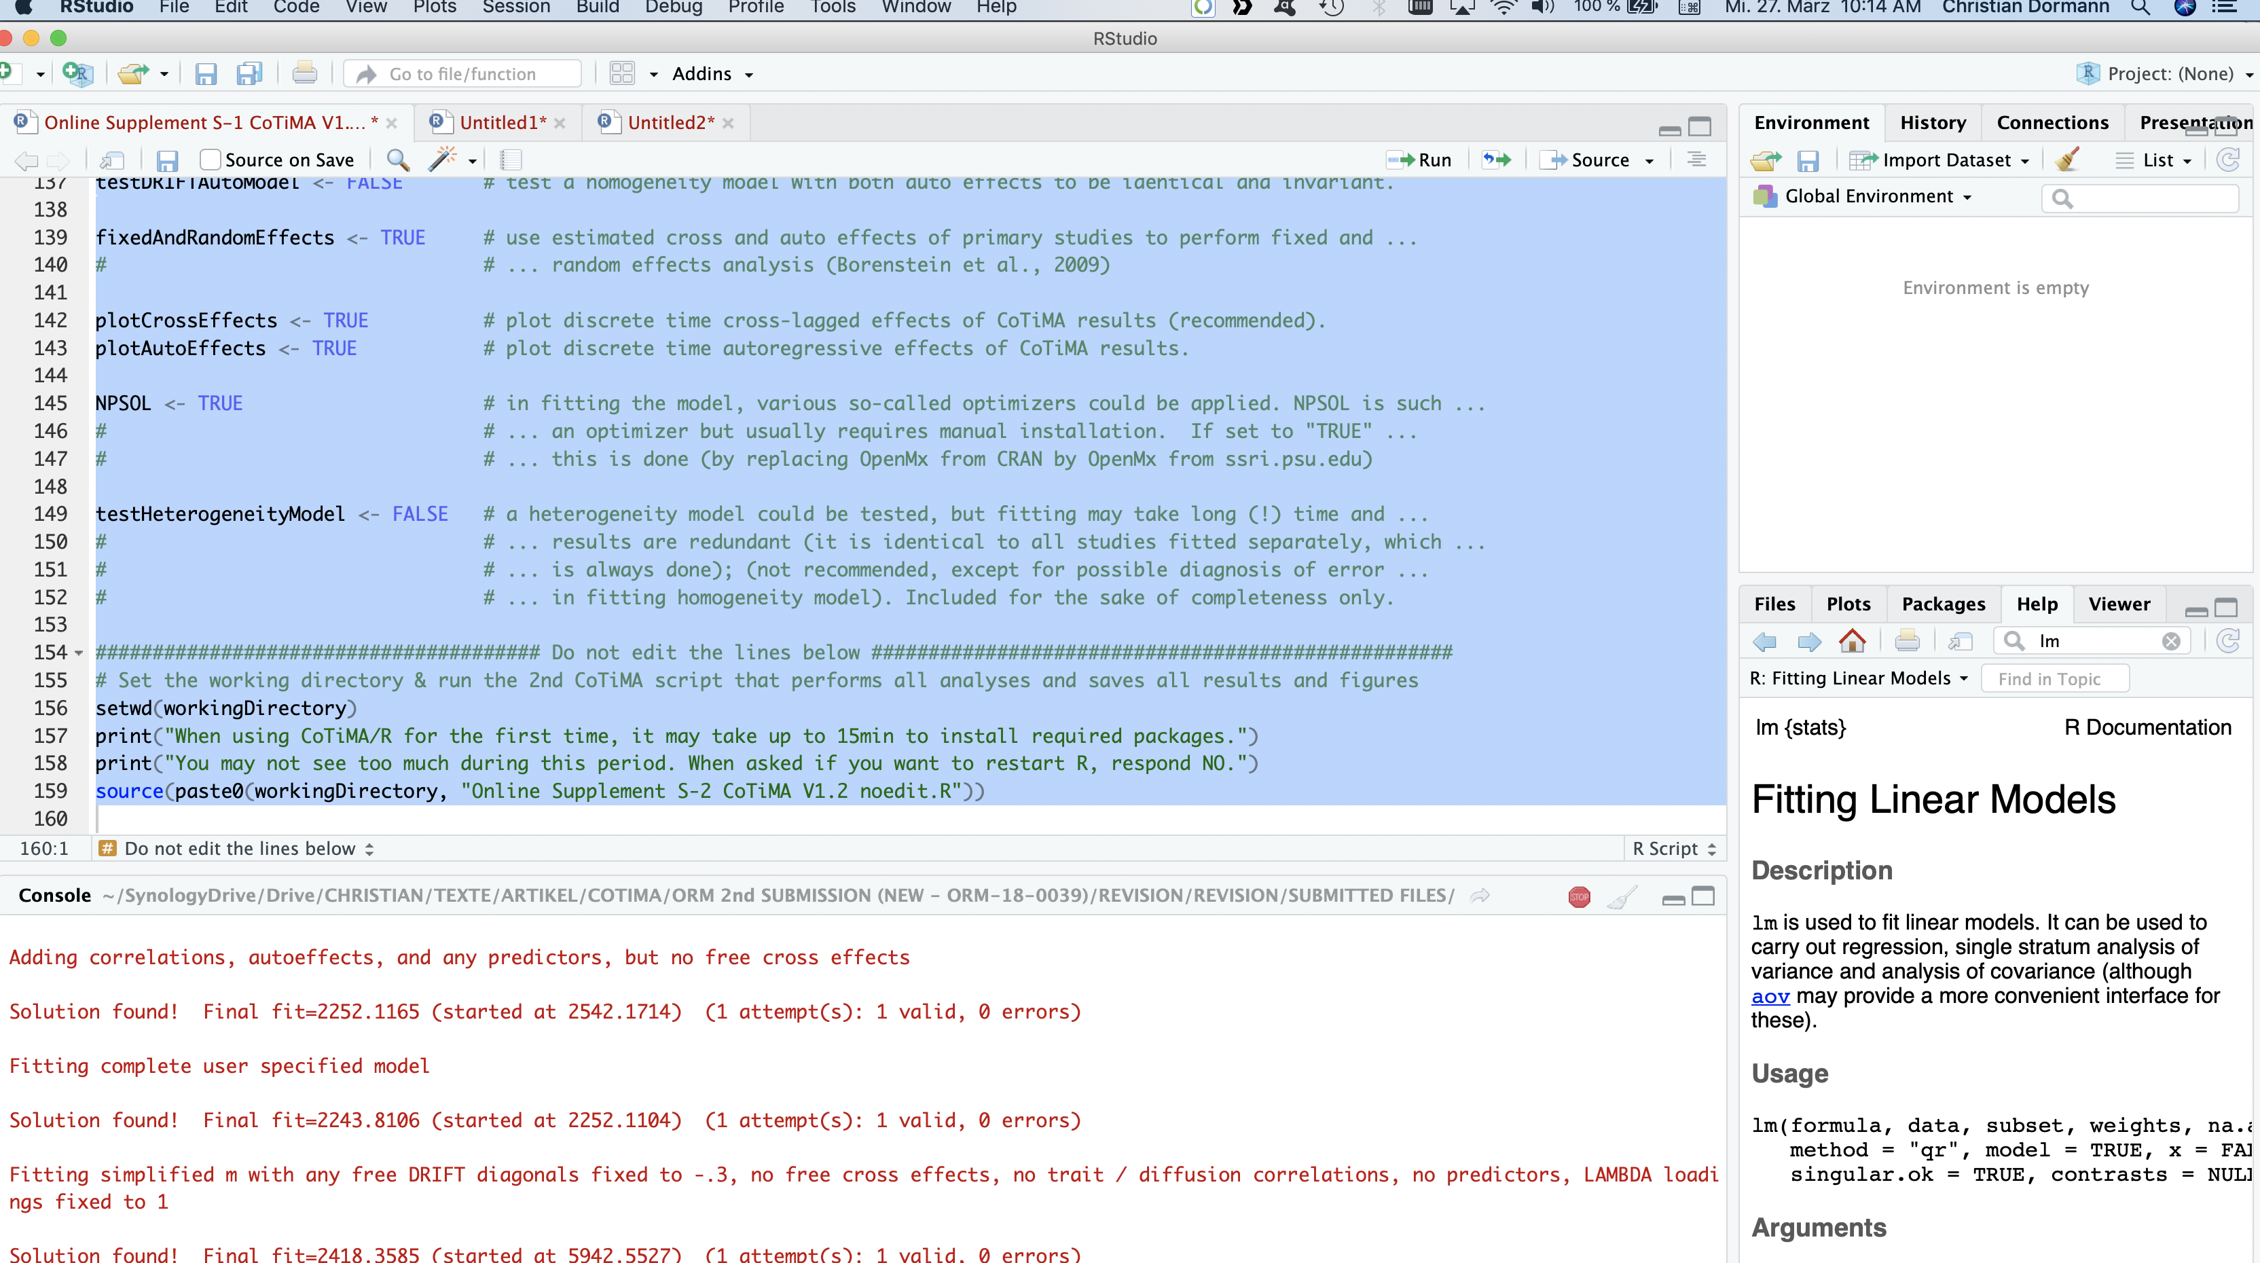
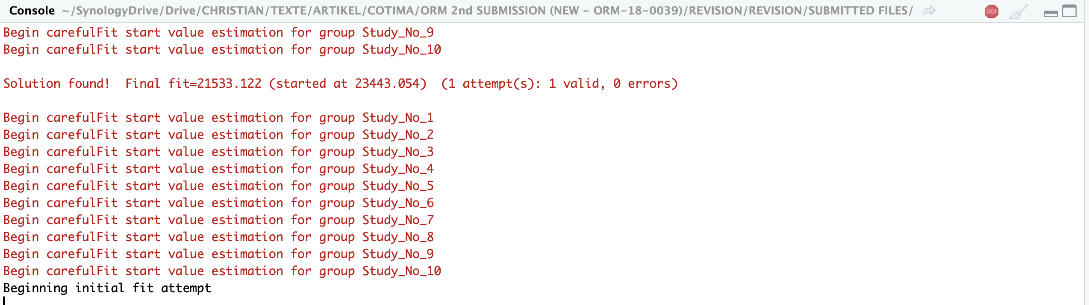
Continuous Time Meta-Analysis CoTiMA
Running
Notes:
Such output in the console …
=> ... Or output of this kind is what you are now going to see for a while …

Slide 19
Continuous Time Meta-Analysis CoTiMA
Waiting
Get you a coffee and wait (on a fast computer 20mins or more)
And the continue with Part II of the Tutorial.
Notes:
So we recommend to get a coffee and wait (on a fast computer 20mins or more)
Perhaps this is a good idea to do right now. Remember: Press the right mouse button to pause in the middle of a slide. Of course, if you encounter such a simple slide as this you could stop the tutorial and start at this or the next slide again

