Slide 1
X
CoTiMA
o
Christian Dormann, Christina Guthier & Jose Cortina
Part II
www.applied-psychology.com

Slide 2
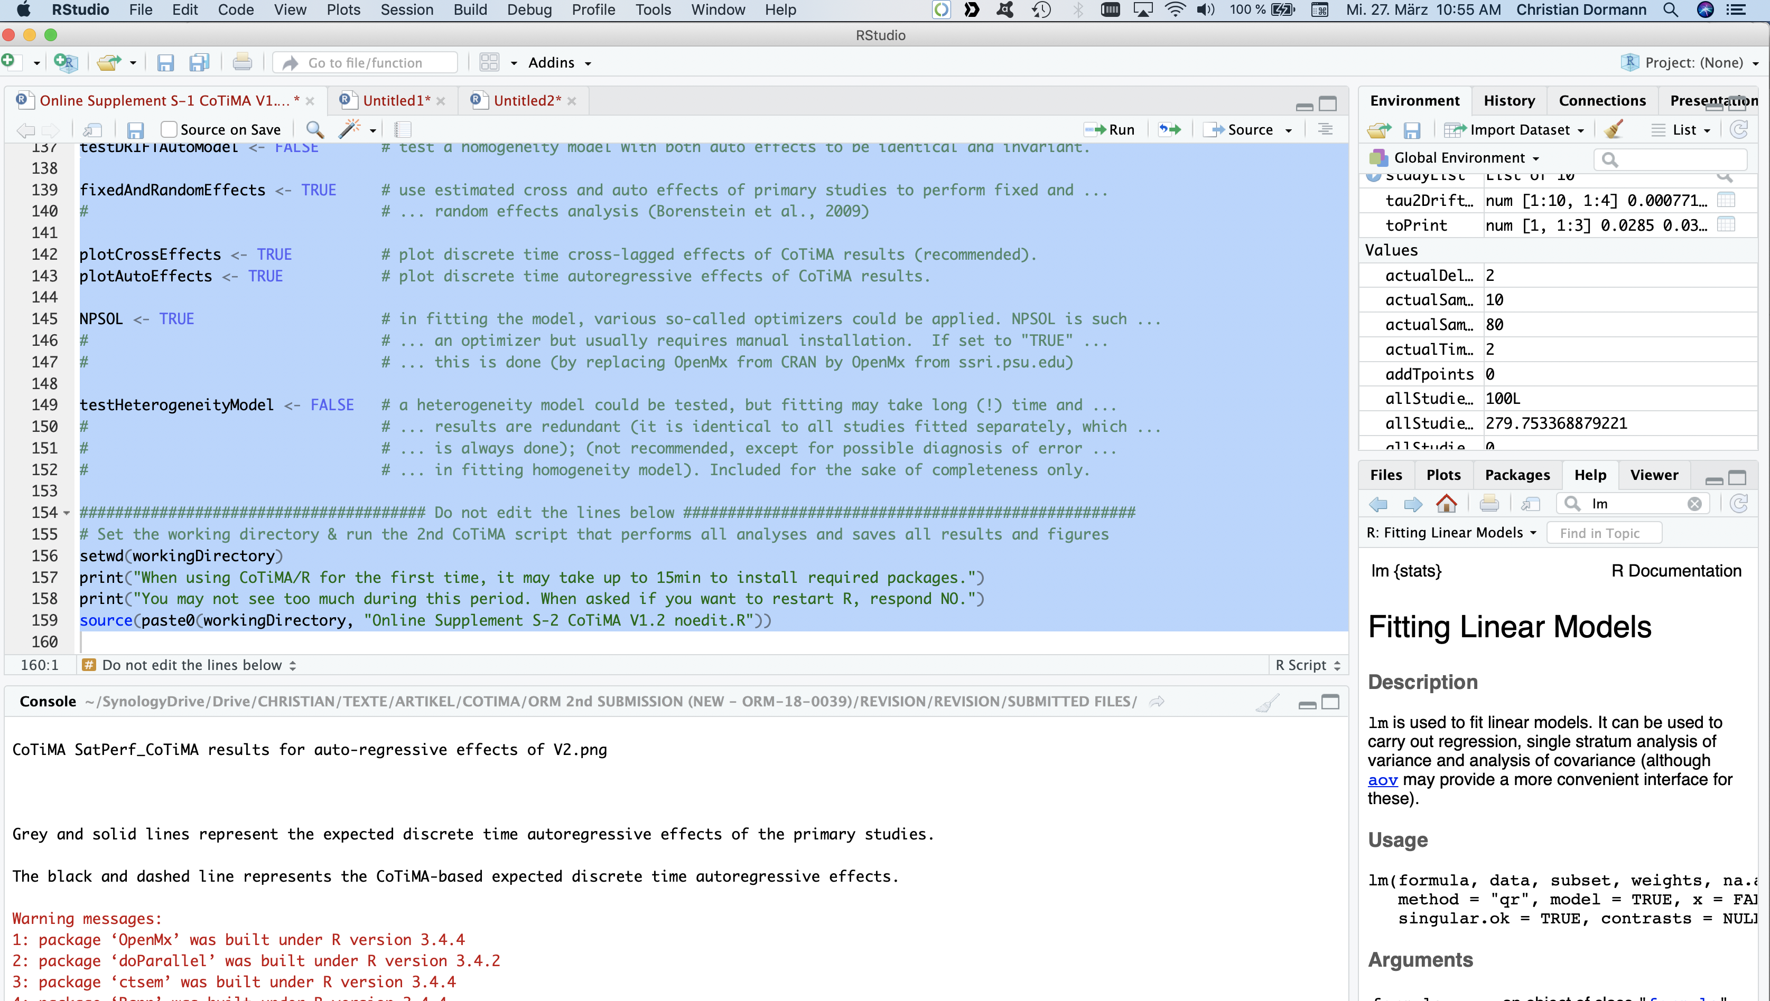

Continuous Time Meta-Analysis CoTiMA
Running
Notes:
CoTiMA has finished if you see such output in the console. The warning messages do not indicaste any problema. Error messages do, warning massages typicall do not.
You could also see that CoTiMA has finished because the top right pane has now been populated. But this is not of much imporance for us because everything has also been sabe in an ourput file.

Slide 3
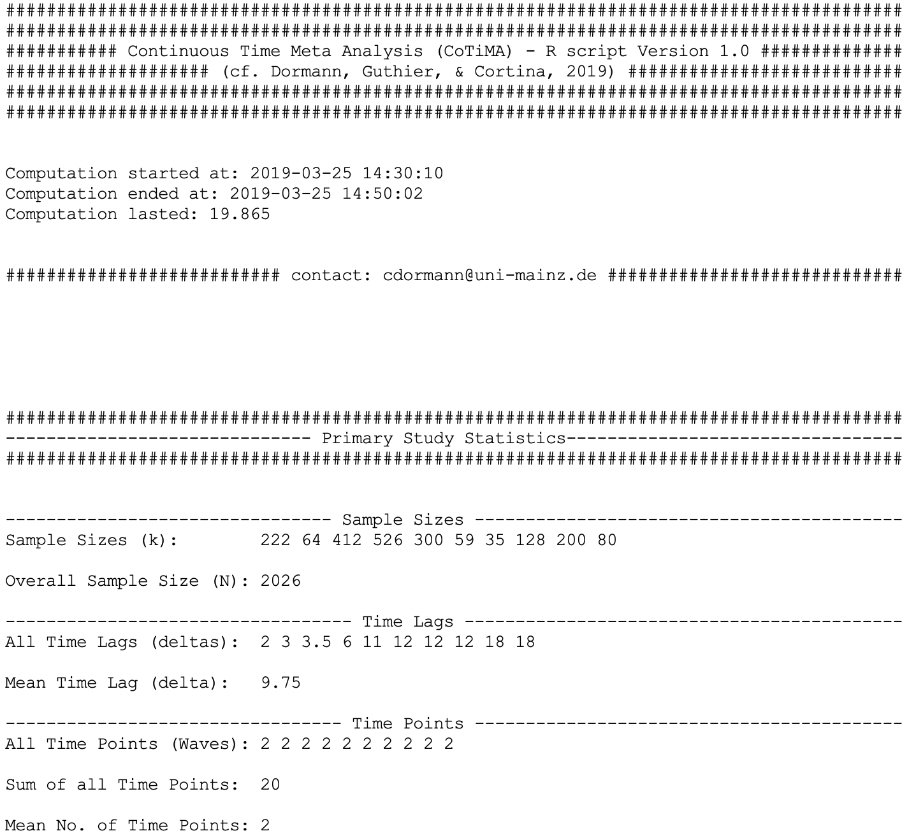
Continuous Time Meta-Analysis CoTiMA
Interpreting the Output
Notes:
You should now find a file with the name “CoTiMA SatPerf.txt” in your working directory,
This file could be opened by any text editor or in Word or otherword processing programs.
We will no guide you through this file.
In this line you see the sample sizes of the k studies of your CoTiMA.
They are in the same order as you entered them
Then there is the overall sample size, which is 2026.
Here we have all time lags used in the primary studies, in this case sorted by length.
Then there is the average time lag used across all primary studies, which is 9.75months.
This list shows the number of waves used by each study from Study 1 to Study 10. In our case, all studies used 2 waves.
Finally, the sum of all time points is 20. Admittedly, this is not very interesting.

Slide 4
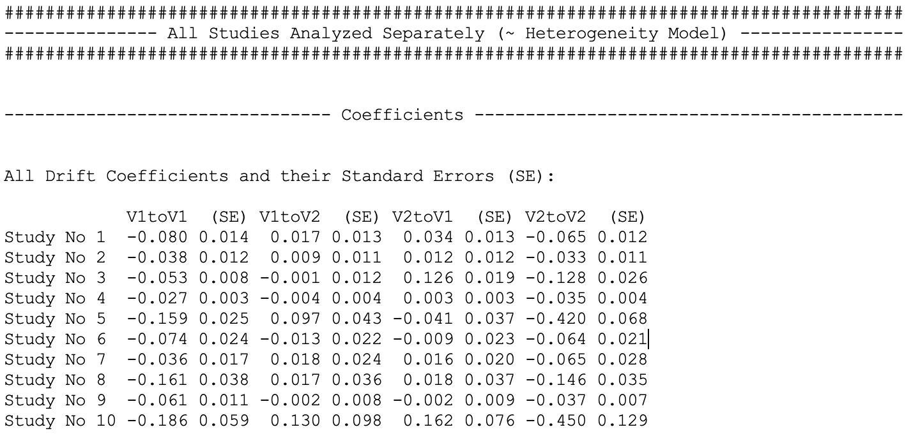
Continuous Time Meta-Analysis CoTiMA
Interpreting the Output
Auto
Effect
Cross
Effect
Cross
Effect
Auto
Effect
Notes:
Now it gets very interesting. Here are the results of a continuous time structural equation model separately fitted to each of the 10 studies.
The effect V1toV1, which indicates the effect of Variable Number 1 on itself across time, and the effect V2toV2, which indicates the effect of Variable Number 2 on itself across time, are the continuous time auto effects.
Thus, V1toV1 is the auto effect of job satisfaction and V2toV2 is the auto effect of job performance.
The effect V1toV2, which indicates the effect of Variable Number 1 on Variable number 2 across time, and the effect V2toV1, which indicates the effect of Variable Number 2 on Variable number 1 across time, are the continuous time cross effects.
Thus, V1toV2 is the cross effect of job satisfaction on job performance. Conversely, V2toV1 is the cross effect of performance on satisfaction
A look at the auto effects reveals they are all negative. This has to be in continuous modeling because of the math involved.
As a heuristic, you could add one to them to see in which study the variable were more or less stable. Alternatively, you may know that the less stable a variable is, the more negative its auto effect becomes, and the more stable a variable is, the closer its auto effect comes to zero. Anyway, we show later how these effects translate into discrete time auto-regressive effects that we usually deal with in regression or structural equation models.
Let us look at the cross effects.
Let us look at the V1toV2 effects, that is, the effects of earlier job satisfaction on later performance. Contrary to auto effects, this signs of cross effects are interpreted as always. In four studies, they were negative, indicating that an increase in satisfaction leads to an decrease in performance. However, none of these effects was significant. How could we know this?
A coefficient is significant if it is twice as large as its associated standard error.
More exactly, the ratio of coefficient divided by its standard error ist the so-called T-value and it should exceed 1.96, which is the critical value in the standard normal distribution. This is not the case for any of the negative coefficients, but it applies to the effect of job satisfaction on performance in study number five.
We can use this effect to illustrate the difference between discrete time and continuous time modeling. Study number 5 used a time lag of 11 months, and if standard regression or structural equation model would be used, the cross-lagged effect of performance satisfaction on performance would also become significant. The interpretation would then be: Job satisfaction predicts job performance across a time lag of 11 months.
In continuous time modeling, the interpretation is that Job satisfaction predicts job performance irrespective of the time lag.
As for auto effects, the value of the continuous time cross effect is difficult to interpret, and we show later how they can be translated into discrete time cross-lagged effects .

Slide 5
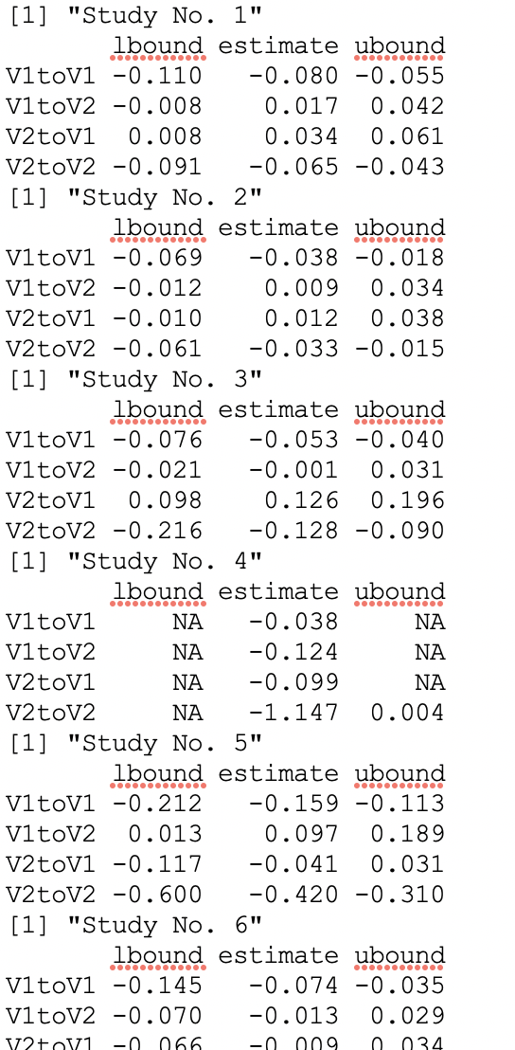
Continuous Time Meta-Analysis CoTiMA
Interpreting the Output
Notes:
Instead of relying on the ratio of a coefficient divided by its standard error, confidence intervals are usually better because they may actually not be symmetric.
For example, looking a Study number five again, we see that the confidence interval for the effects of satisfaction on performance, that is, the effect of V1toV2, range from plus 0.013 to plus 0.189

Slide 6
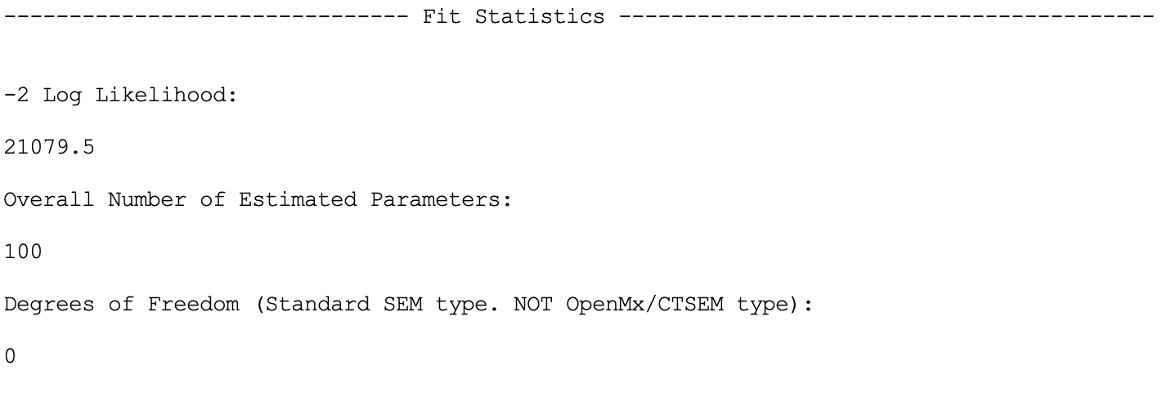
Continuous Time Meta-Analysis CoTiMA
Interpreting the Output
Notes:
Next, the fit statistics for a heterogeneity model are displayed. A heterogeneity model is a model in which all auto effects and all cross effects are independently estimated for each primary study.
In many structural equation programs a Chi-square value, the degrees of freedom, and the significance
of the Chi-square value are shown. The Chi-square value is essentially based on the so-called minus two loglikelihood value, which is used in continuous time modelling.
The value itself does not have any meaning, but it can be used to compare different models to determine which model fits better. If you know the Chi-square difference test – this is essentially identical to a minus two loglikelihood-difference test.
The output also shows that overall 100 parameters were tested.
And there were zero degrees of freedom.
We should mention here that in the statistical packages used for CoTiMA do compute the degrees of freedom in a different way than most well-know structural equation programs such as MPLUS or AMOS. In the CoTiMA output, however, we converted them so that they are in line with what MPLUS or AMOS users would expect.

Slide 7
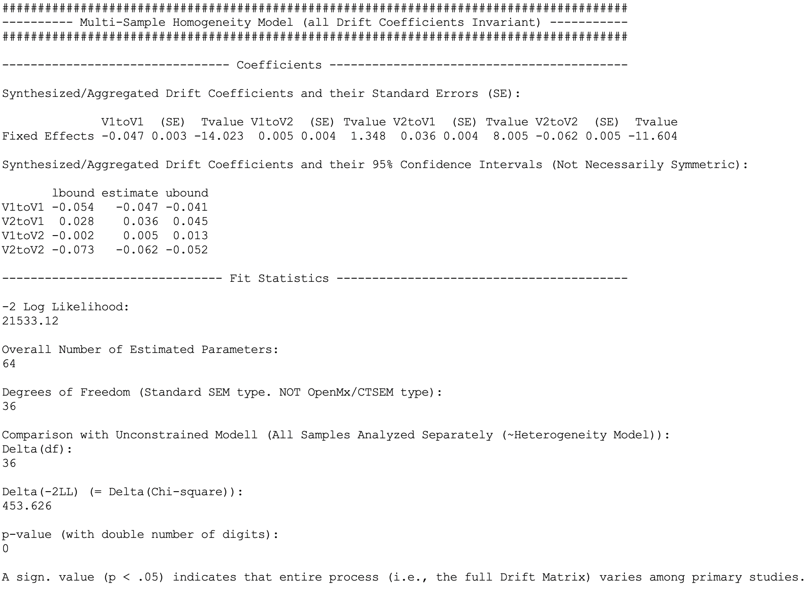
Continuous Time Meta-Analysis CoTiMA
Interpreting the Output
Notes:
Now we come to the core of CoTiMA. All effects were aggregated across studies. Technically, this was achieved by fitting a multi-simple homogeneity model in which each drift coefficient was forced to be invariant across the ten primary studies. And this was done for all four drift coefficients simultaneously, so for both auto effects and both cross effects. Here are the results.
The aggregated auto effect of job satisfaction is negative as expected and explained earlier.
The value is -.04, and we show soon what this does mean in discrete time. The associated T-value shows this value is more than 14 times larger than its standard error. As also mentioned earlier, if the T-value is larger than plus 1.96 or smaller than -1.96, and effect is significant. So this effect is highly significant.
The significance of the auto effect of job satisfaction can also been identified by looking at the 95-percent confidence interval below. The interval does, as expected, not include zero.
If we now look at the aggregated cross effect of job satisfaction on job performance, the T-value indicates that it is not significant, and the confidence interval does in fact include zero.
The interpretation is: job satisfaction does probably not affect job satisfaction. It does probably not do so at neither time lag.
For the reversed effect of job performance on job satisfaction, however, we see that the T-value is significant and the confidence interval does not include zero.
The interpretation is: Job performance predicts an increase in job satisfaction across time. In fact, across all time lags.
Finally, to auto effect of job performance is also significant.
This multi-sample homogeneity model, which is the core CoTiMA model, also has a minus-two-loglikelihood value and degrees of freedom.
When compared to the previous heterogeneity model, the difference in the degrees of freedom is 36 and the difference in the loglikelihood values is 453.626.
This is identical of what one would observe using a Chi-square difference test. The difference is highly significant. This indicates that the auto and or cross effects vary significantly across primary studies. However, if one wants to have a single best estimate for each coefficient, then these are the values provided at the top of this slide. As mentioned, this is the most important outcome of CoTiMA.

Slide 8
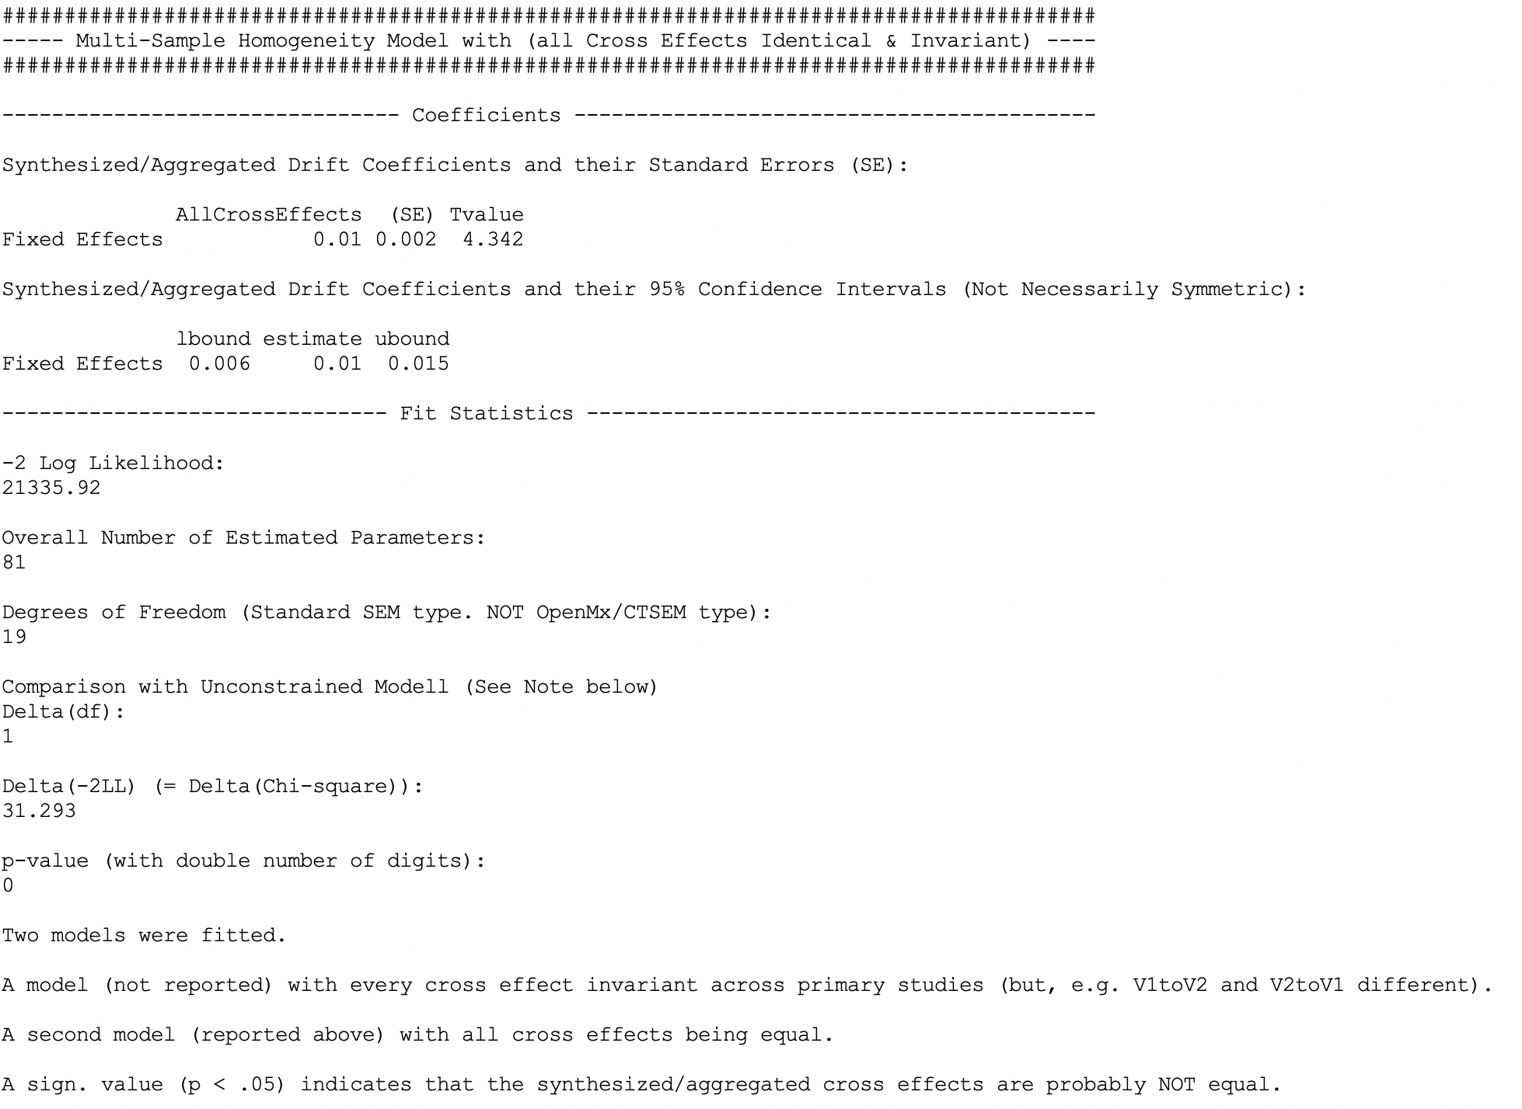
Continuous Time Meta-Analysis CoTiMA
Interpreting the Output
Notes:
In several cross-lagged studies, researchers want to know if the two cross-lagged effects are identical or if one effect is larger than the other one.
This could also be addressed with CoTiMA. A model was fitted in which the effects of job satisfaction on job performance were assumed to be identical and also invariant across all primary studies. If this would be true, than the two cross effects were probably both .01.
This effect would be significant as indicted by the T-value exceeding 1.96 and the confidence interval, which does not include zero.
However!
A log likelihood difference test was performance. Compared with an unconstrained model, in which the two cross effects were different, one degree of freedom was saved, but the loglikelihood difference was as large as 31.293. This is highly significant.
What we knew before was that satisfaction does not affect performance.
We also knew before that performance does affect satisfaction.
And we now added to our knowledge that the effect of performance on satisfaction is significantly stronger.

Slide 9
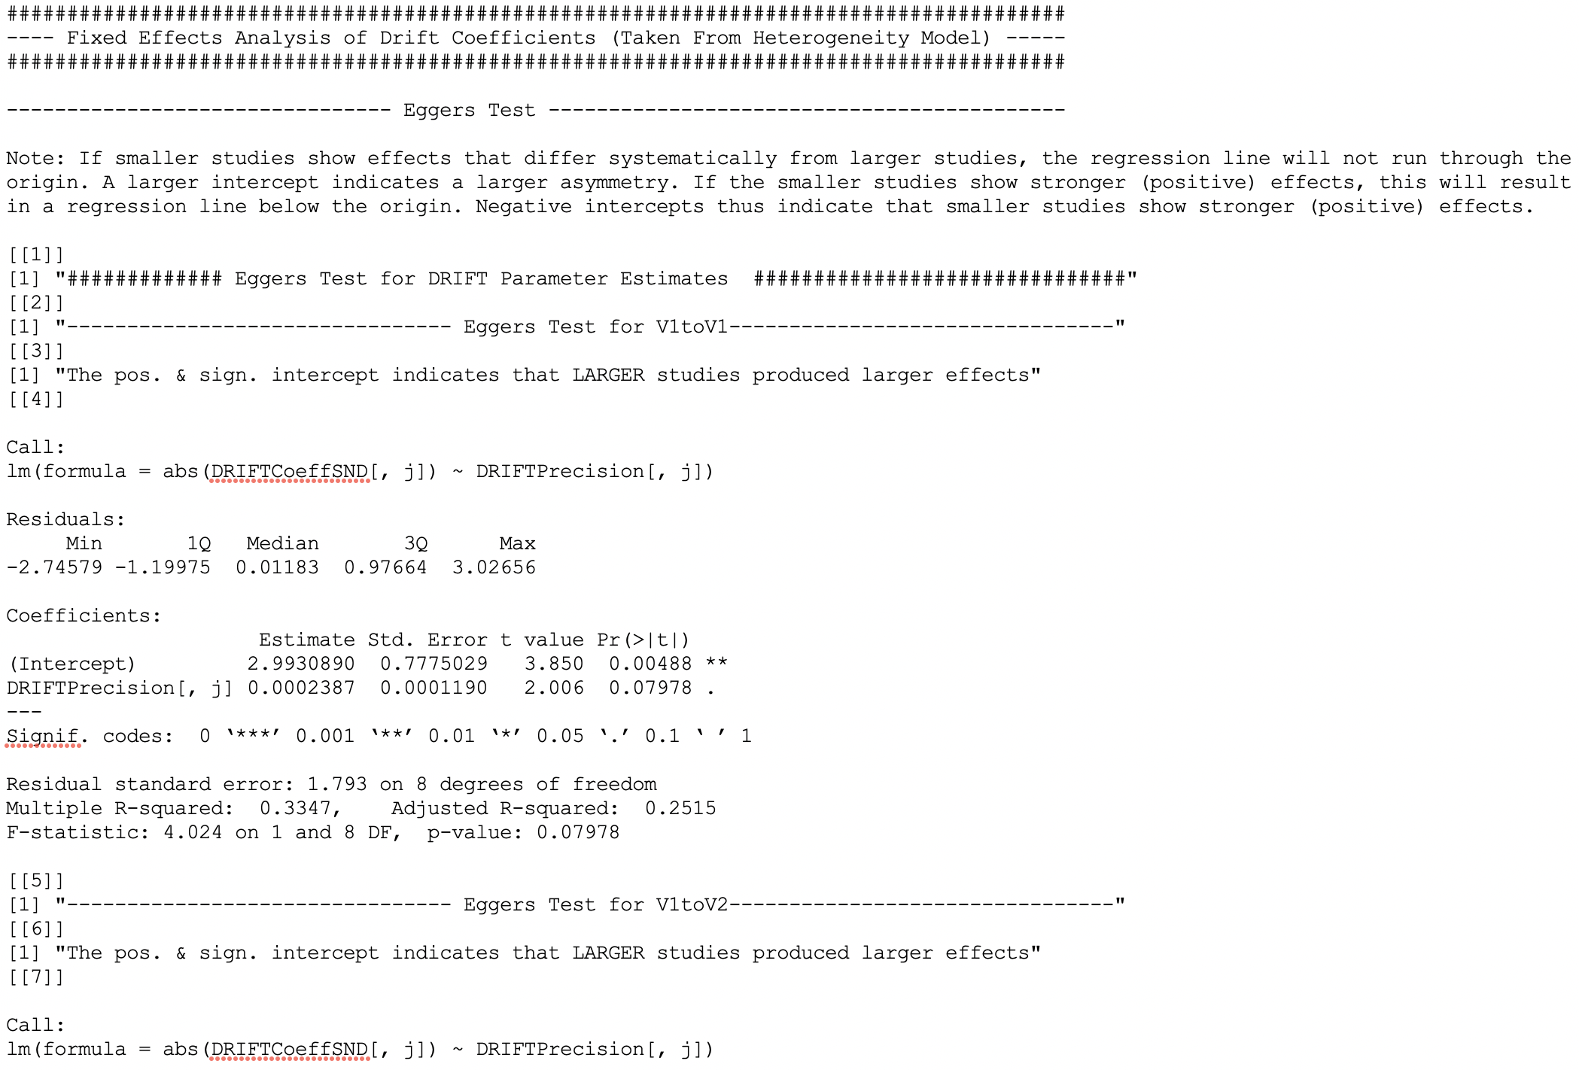
Continuous Time Meta-Analysis CoTiMA
Interpreting the Output
Notes:
Recall that we have requested results from a fixed-and-random-effects analysis. What CoTiMA then does is performing fixed-and-random-effects analyses for each of the four drift coefficiencts.
What is also does is performing the Egger’s test for each of the four coefficients. Egger’s test is frequently used in meta-analysis.
Stated very briefly, when performing Egger’s test, the so-called standard normal deviate (SND) is regressed against the inverse of the standard error of the coefficient. The inverse of the standard error of the coefficient is also called precision. The point is that without a selection bias, the regression line can be expected to run through the origin. In other words, the intercept should be zero.
=> In this case, we have the results for the auto effect of job satisfaction, that is, V1toV1.
The regression result shows that the intercept is positive and significant.
And the interpretation is delivered above: The positive and significant intercept indicates that Larger studies produced larger effects. Larger effects in auto effects closer to zero. This means that in larger studies job satisfaction was more stable than in smaller studies. Conversely, job satisfaction was less stable in smaller studies.

Slide 10
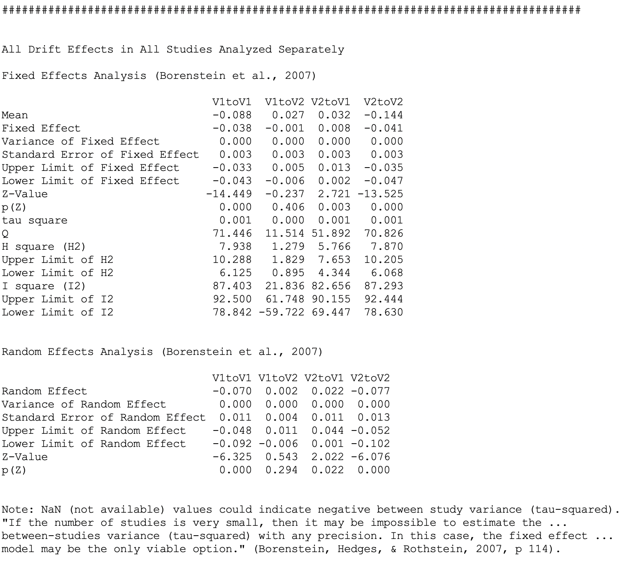
Continuous Time Meta-Analysis CoTiMA
Interpreting the Output
Notes:
The results from the fixed and random effects analysis are shown on this slide. In plain words, a fixed effects analysis computes a weighted average effect based on the assumption that all primary studies were conducted in the same population. Contrary, a random effect analysis assumes that the effects in the primary studies may be based on different populations and vary around a common so-called true effect.
At the top you see the results of the fixed effects analyses for the four drift coefficients.
You could easily see that the simple mean is different from the weighted mean, which is called the fixed effect.
The fixed effects have their standard errors and their confidence intervals to assess their significance.
The I-square value indicates the degree of heterogeneity in the effects across primary studies. I square also as a confidence interval.
You see here that the confidence interval of the effect of job satisfaction on performance, that is, V1toV2, includes zero. This means that this effect does not significantly vary among primary studies, whereas the other three effects do.
Then come the results from random effect analyses.
Okay, these are a lot of numbers. However, one could make a long story short.
The fixed effect of satisfaction on performance is not significant as indicated by the top red rectangle, it does not vary much across primary studies as indicated by the middle red rectangle, and its random effect is not significant either.
I repeat this: The fixed effect of satisfaction on performance is not significant as indicated by the top red rectangle, it does not vary much across primary studies as indicated by the middle red rectangle, and its random effect is not significant either.
All other effects – either fixed or random. -are significant and vary considerably across primary studies.

Slide 11
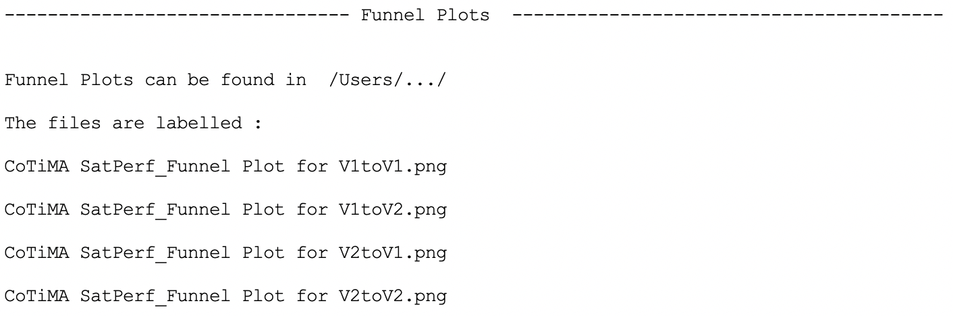
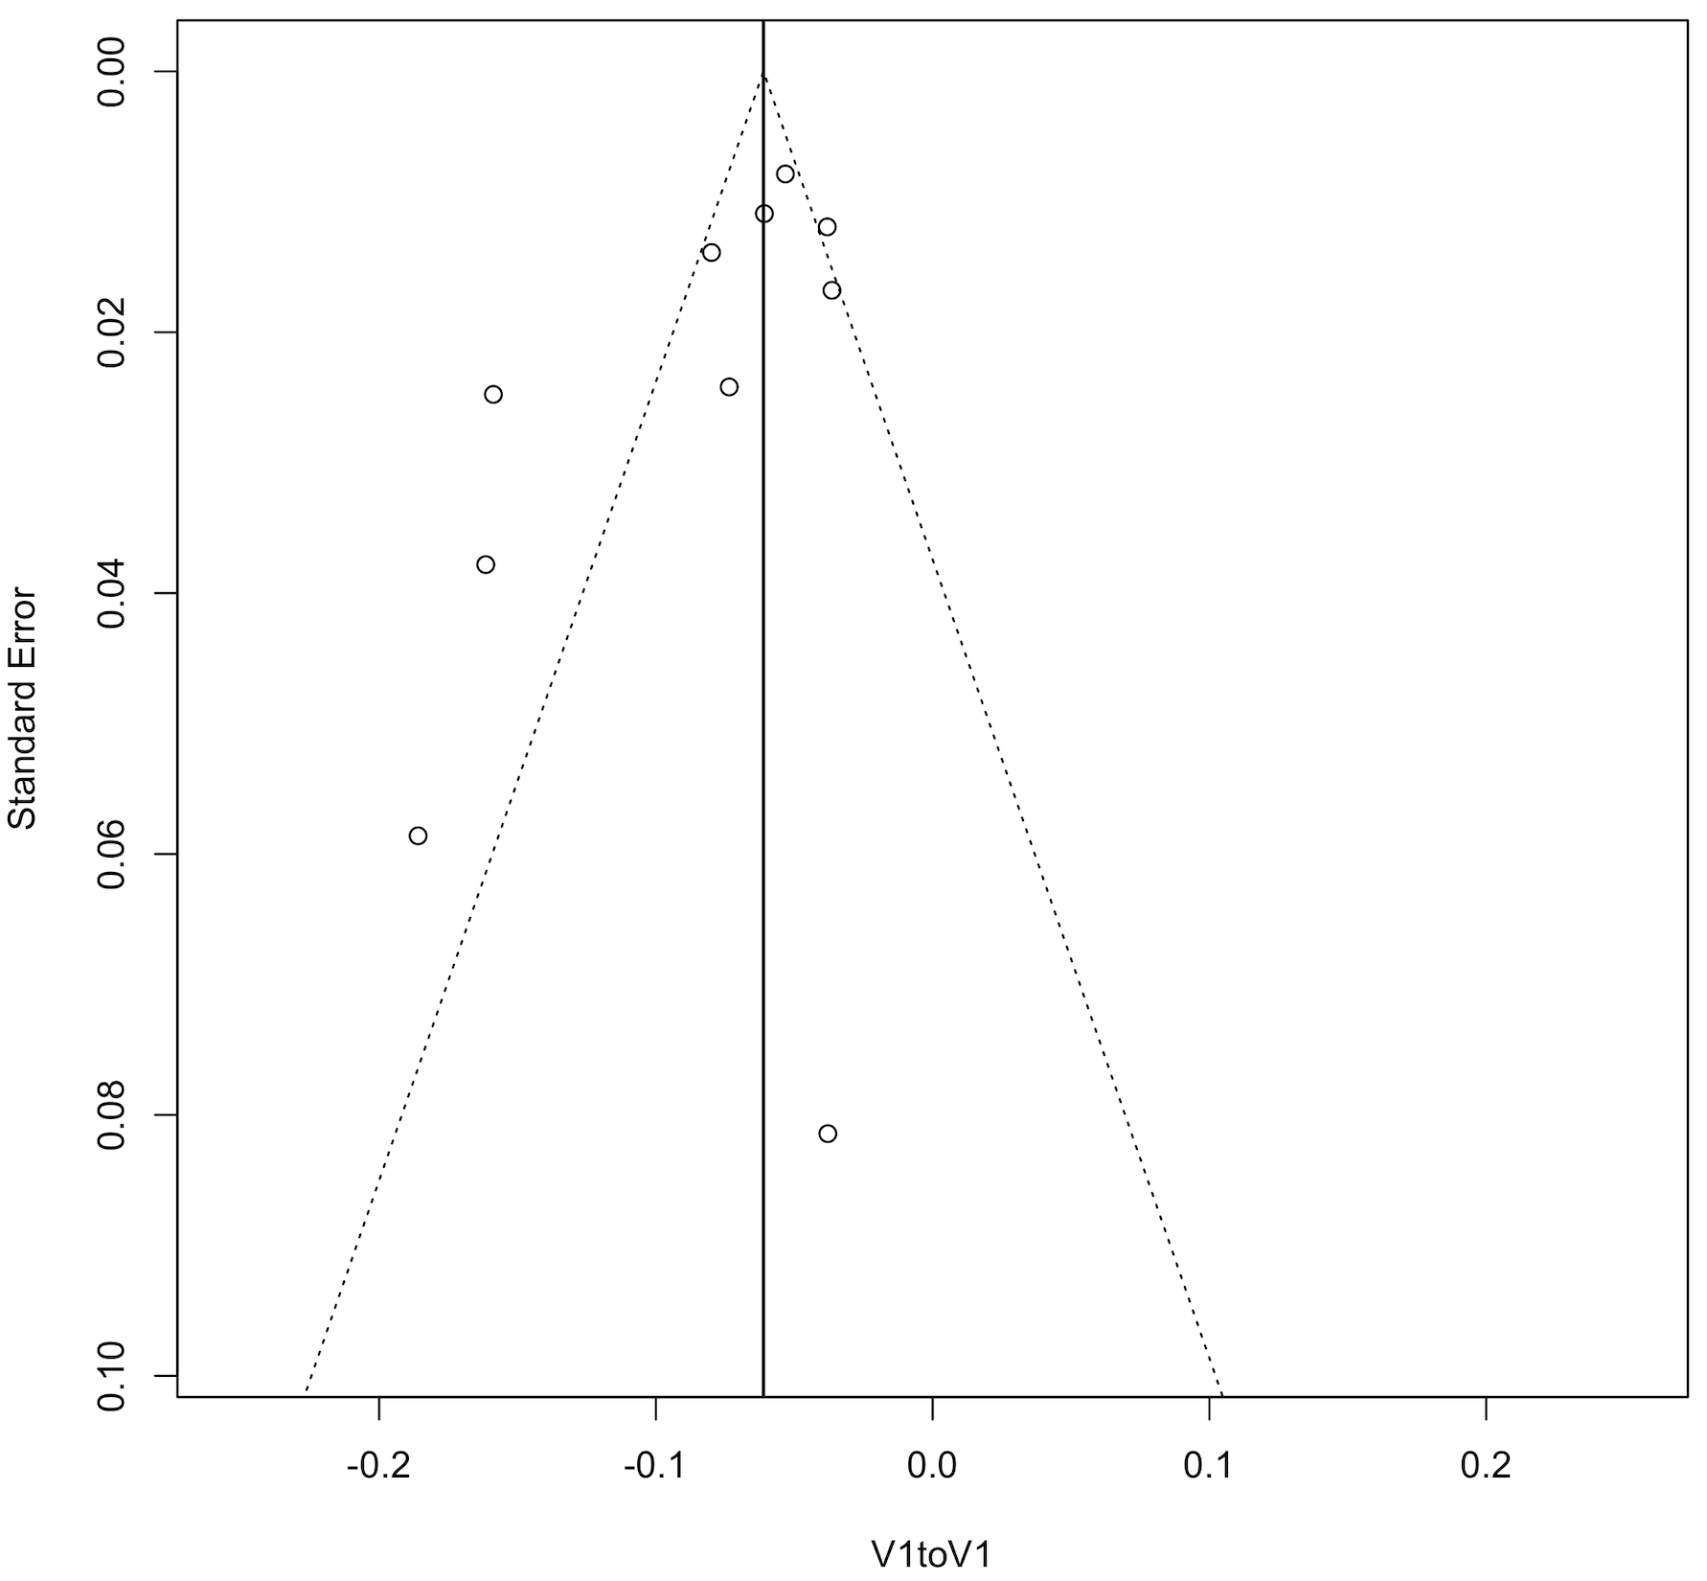
Continuous Time Meta-Analysis CoTiMA
Interpreting the Output
Notes:
What you can also get from CoTiMA by requesting fixed and random effect analyis is funnel plots. In brief, in funnel plots the effect size is plotted on the horizontal axis, and measures that captures the sample size is plotted on the y-axis. As measures that captures the simple size researchers frequently use the standard error of the estimates. Thus, effects of larger studies are plotted at the top of the figure and effects of smaller studies more at the bottom.
=> Here you see the funnel plot for the auto effect of job satisfaction, that is, V1toV1.
What you see here is that – with the exception of on study located at the bottom – some smaller studies tend to produce lower effect sizes. That is, job satisfaction is lass stable in smaller studies, and more stable in larger studies.
We new this before because of the result of Egger’s test shown 2 slides before. Thus, we also know this effect is significant. This could indicate possible publication bias. But it could also indicate other systematic differences between smaller and larger studies. For example, smaller studies may tend to investigate a sample coming from a smaller range of jobs compared to larger studies. Range restriction is now to reduce correlations, and thus, auto effects too.

Slide 12
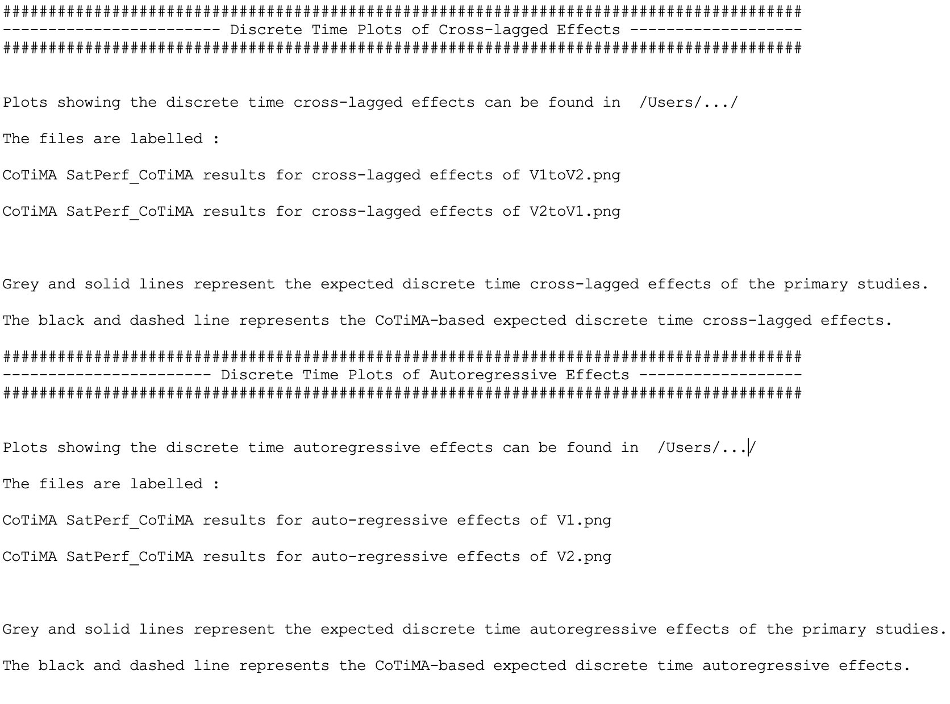
Continuous Time Meta-Analysis CoTiMA
Interpreting the Output
Notes:
Finally, we also requested plots. This files just shows you where they are located, the file names, and what solid-gres and dashed-black lines stand for. We explain this on the next slide, too.

Slide 13
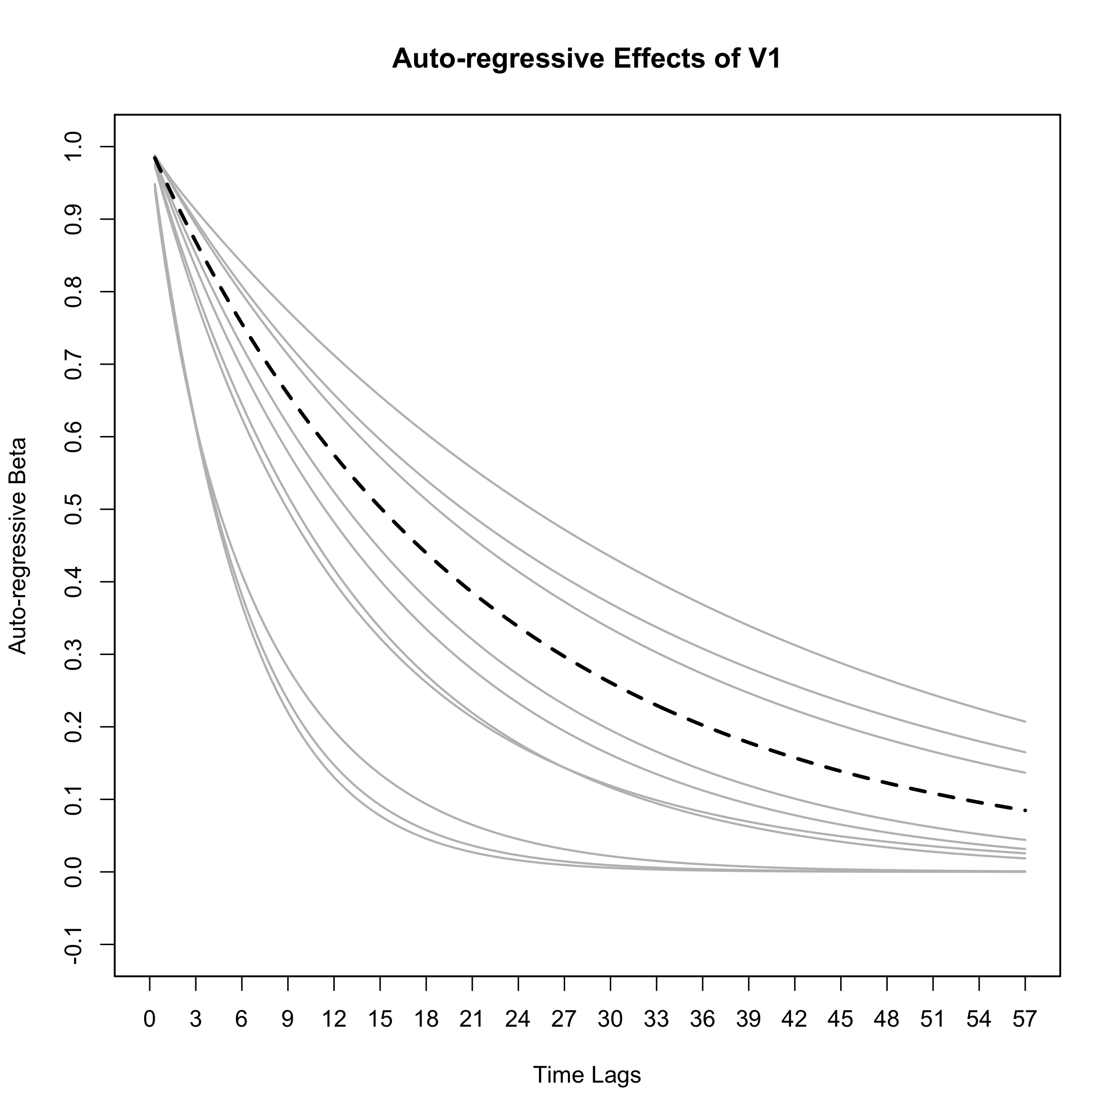
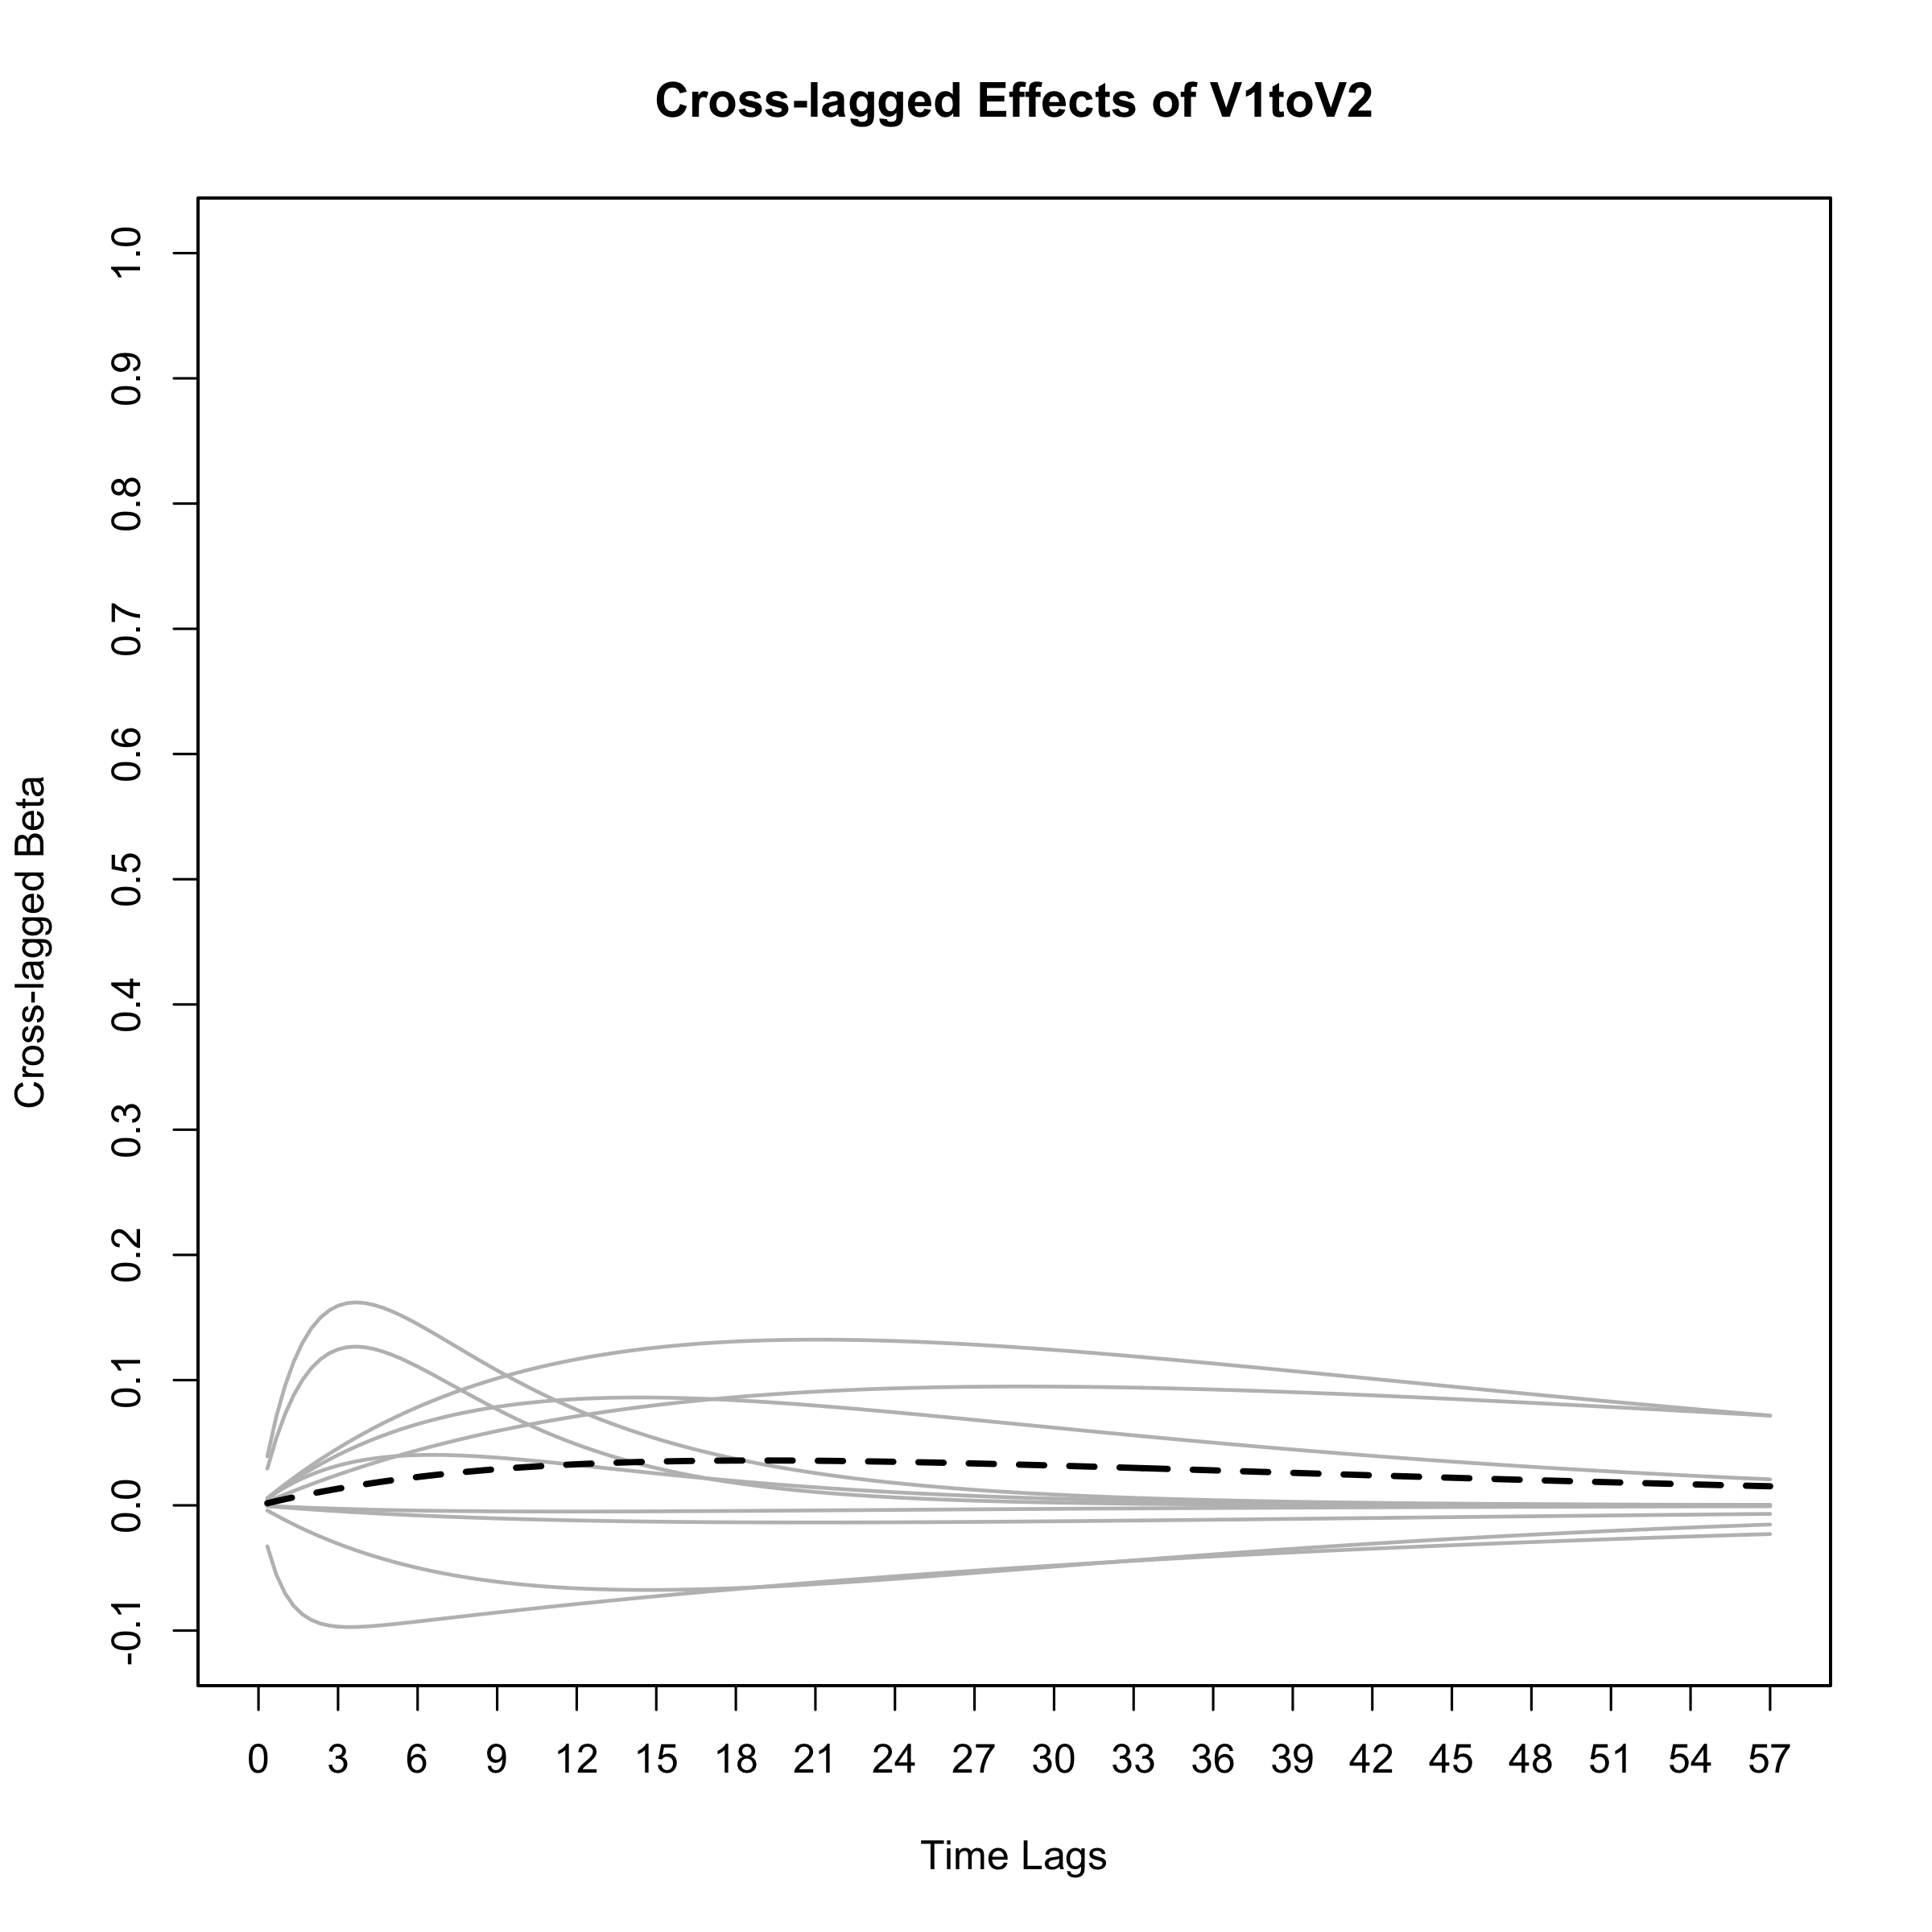
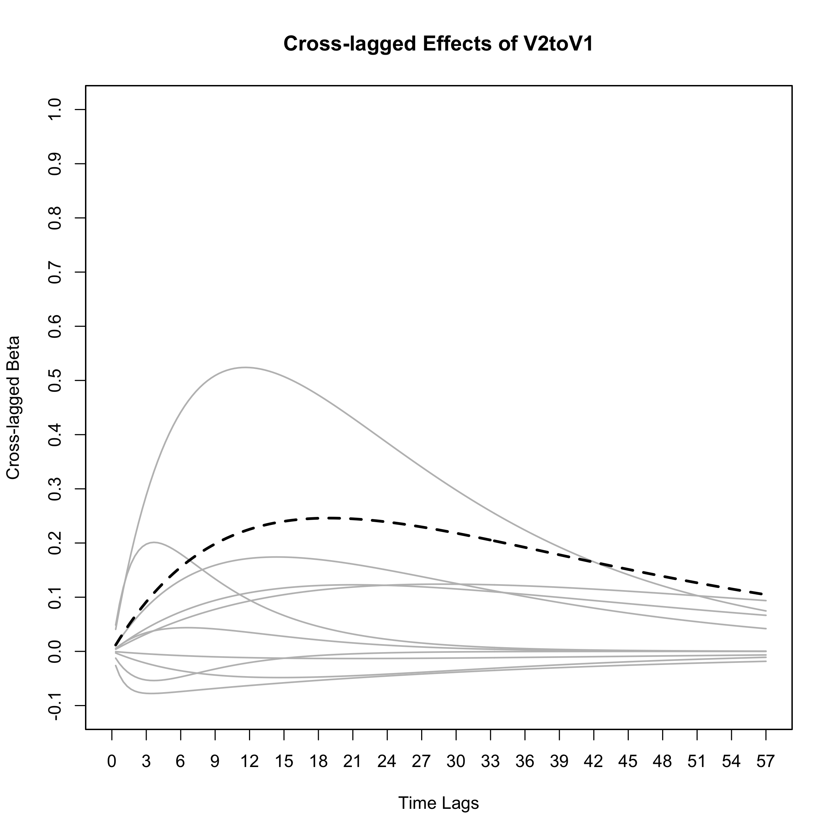
Continuous Time Meta-Analysis CoTiMA
Interpreting the Output
Notes:
What you see here how the continuous time drift coefficients translate to discrete time effects. In other words, you see here cross-lagged effects of job satisfaction on job performance that one would expect if the studies had applied time lags between one moth and almost 5 years.
The grey slopes represent the 10 primary studies, and the dashed black slope represents that meta-analyzed, that is, the aggregated effect.
As you can see, the aggregated effect does not change much across the different possible time lags. Its is very small on the left side representing short lags, then it becomes a bit stronger, and then it levels off the longer the time lags become, that is, the more we move to the right.
Recall that CoTiMA has revealed this effect to be not significant. The correct interpretation is that the effect of job satisfaction on job performance does not exist. It does not exist at any possible time lag.
The next figure shows the reversed effects, that is, the effects of performance on satisfaction. The dashed black line again represents the aggregated effect.
Recall that CoTiMA has revealed a significant continuous time cross effect of performance on satisfaction. The correct interpretation is that the effect of job performance on job satisfaction on does exist. It does exist at any possible time lag.
However, this does not mean that it always becomes significant. If the time lag in a study is too small or too long, the effect could become very small and its standard error very large. Thus, it may fail to become significant, but the CoTiMA results says: It is there, but you may not see it.
For autoregressive effects, the shape of the expected effects across different time lags is different. Whereas cross-lagged effects always tend to increase, then reach a mximum, and the start to decline again, auto-regressive effects become smaller with increasing time lags.
This is the basic shape that characterizes the distribution of all cross-lagged effects from very short to very long lags. And since time lags have such a non-linear and non-symmetric distribution across time, ….

Slide 14
Continuous Time Meta-Analysis CoTiMA
Our Finish – Your Start
C TiMA
o
Typeset in Times (New Roman)
Notes:
=> … one should better not, for example, categorize primary studies into different time categories and then aggregate effects within each category. Instead, CoTiMA, which is based on stochastic differential equations, much better describes the evolution of effects across time. So it is time. Time to conduct your own CoTiMA.

Slide 15
Continuous Time Meta-Analysis CoTiMA
Suggested Literature
Suggested Literature
Dormann, C., Guthier, C., & Cortina, J. (in press). Introducing Continuous Time Meta-Analysis (CoTiMA). Organizational Research Methods.
Driver, C., Oud, J. H. L., & Voelkle, M. C. (2017). Continuous time structural equation modeling with R package ctsem. Journal of Statistical Software, 77, 1–35. doi:10.18637/jss.v077.i05
Voelkle, M. C., Oud, J. H. L., Davidov, E., & Schmidt, P. (2012). A SEM approach to continuous time modeling of panel data: Relating authoritarism and anomia. Psychological Methods, 17, 176–192. doi:10.1037/a0027543
Notes:
-

